Slide 1
Introduction to Angular
Week 5 Discussion
Slides adapted from Edureka! Angular Tutorial, Big Thanks!

Slide 2
Angular
Angular is an open source JavaScript framework that is used to build single page based web applications.
Developed by Google
Release Date - March 2017
One framework. Mobile & Desktop.

Slide 3
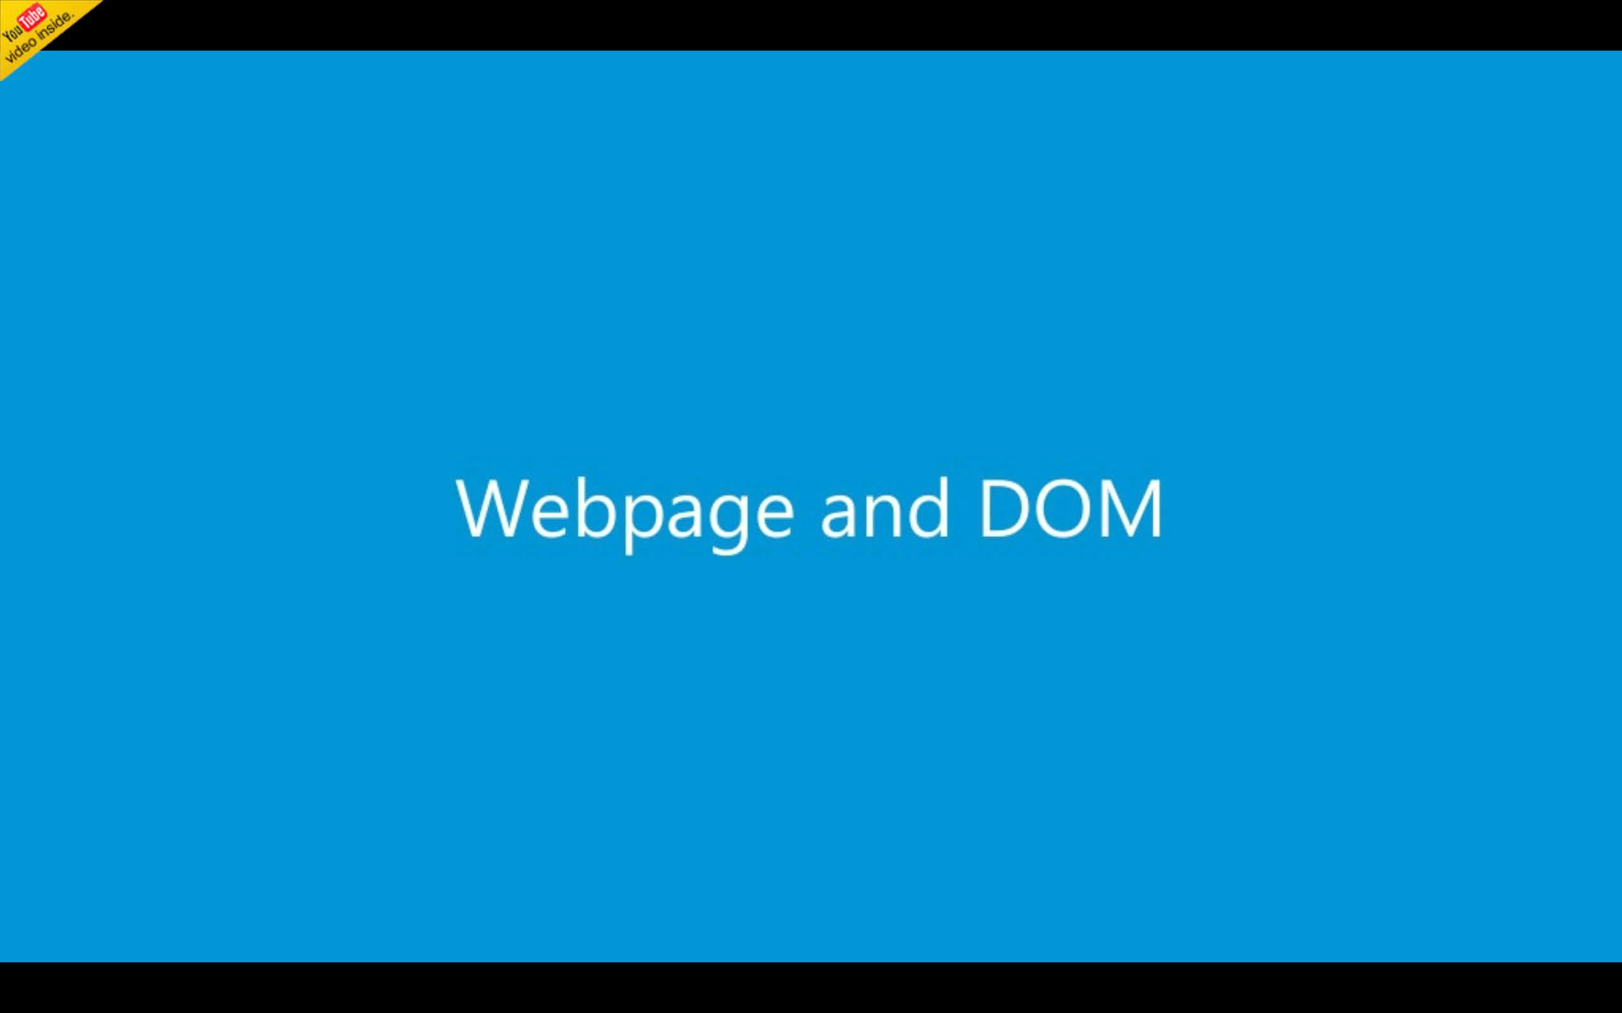
Revisit the traditional Web Dev …

Slide 4
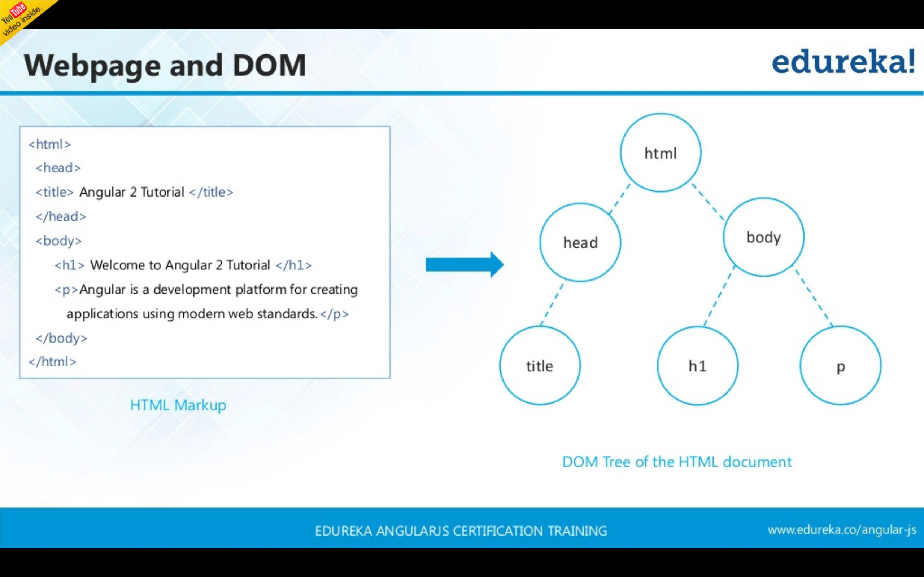

Slide 5
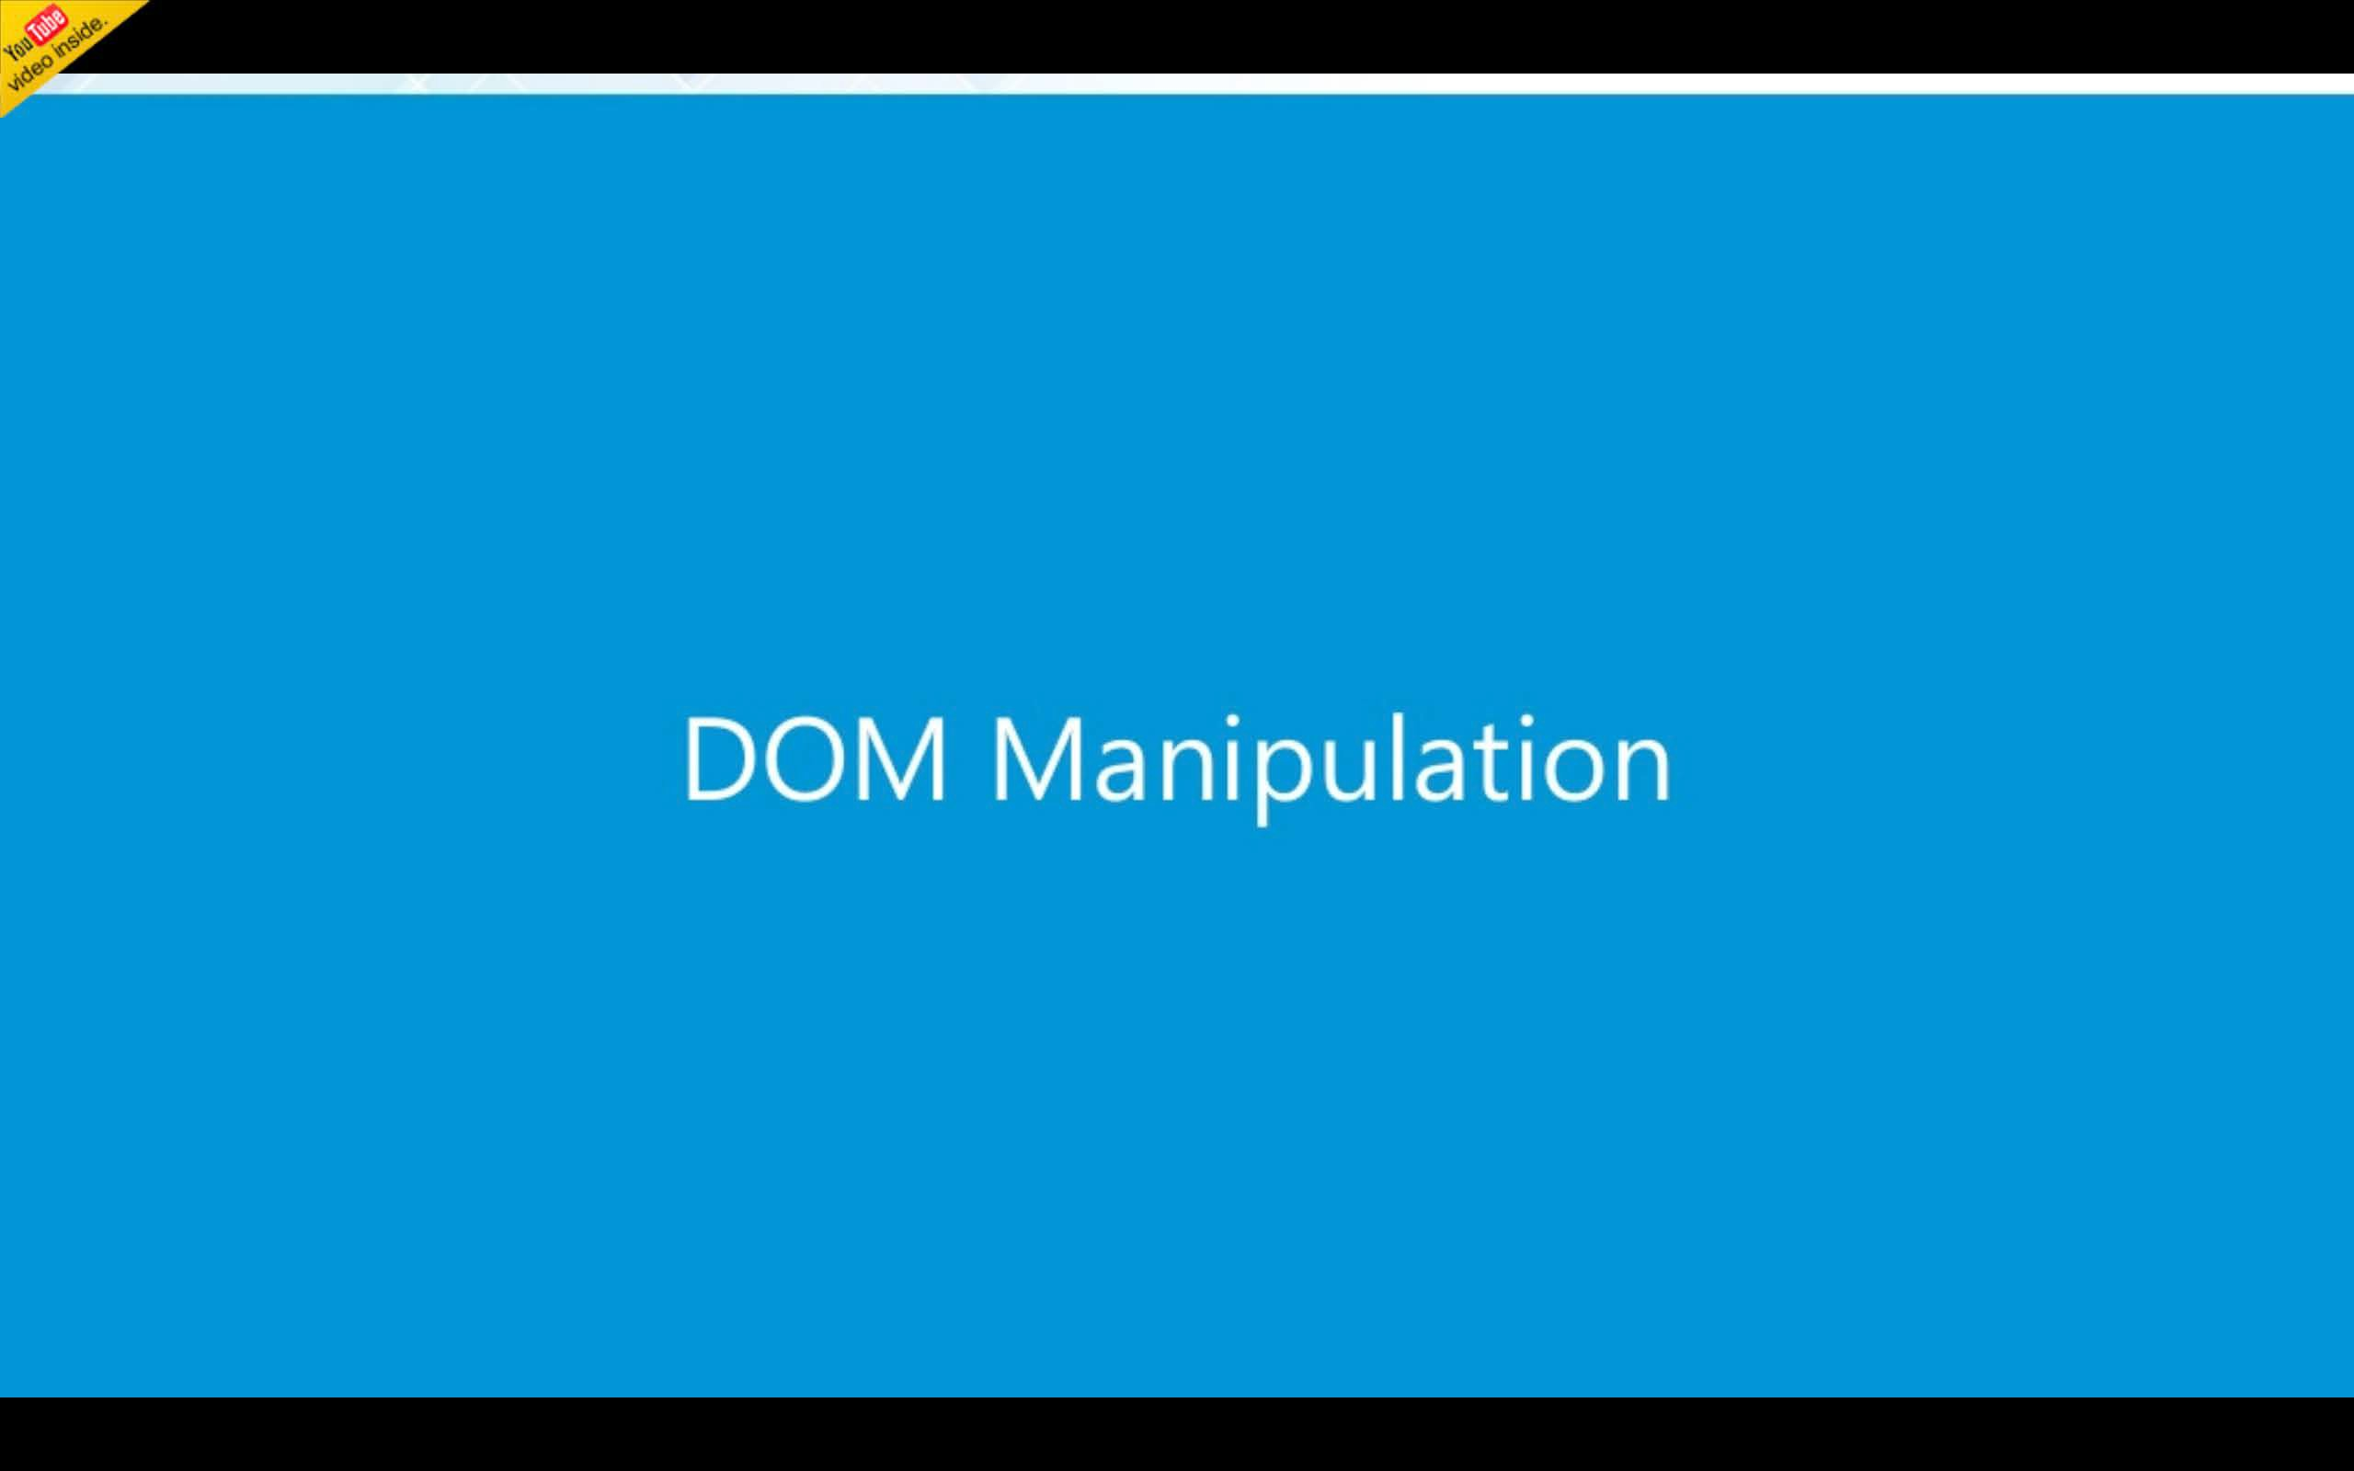

Slide 6
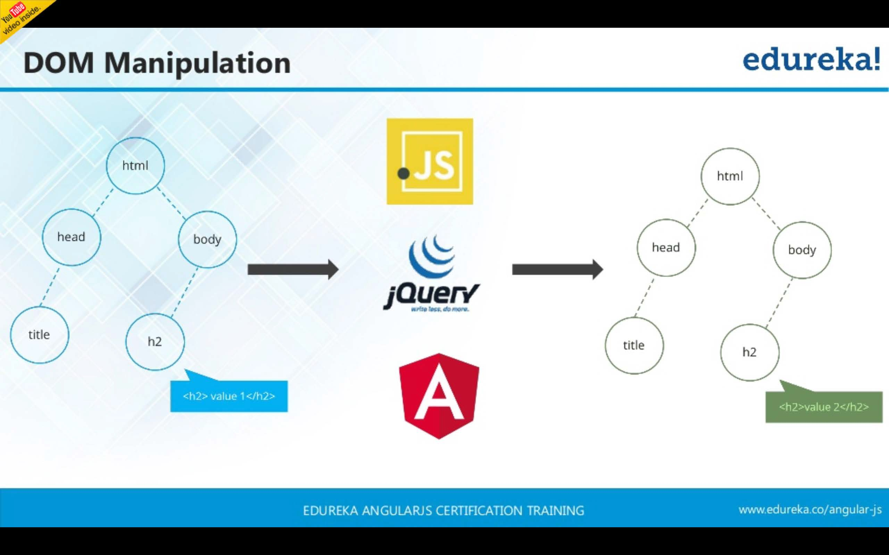

Slide 7
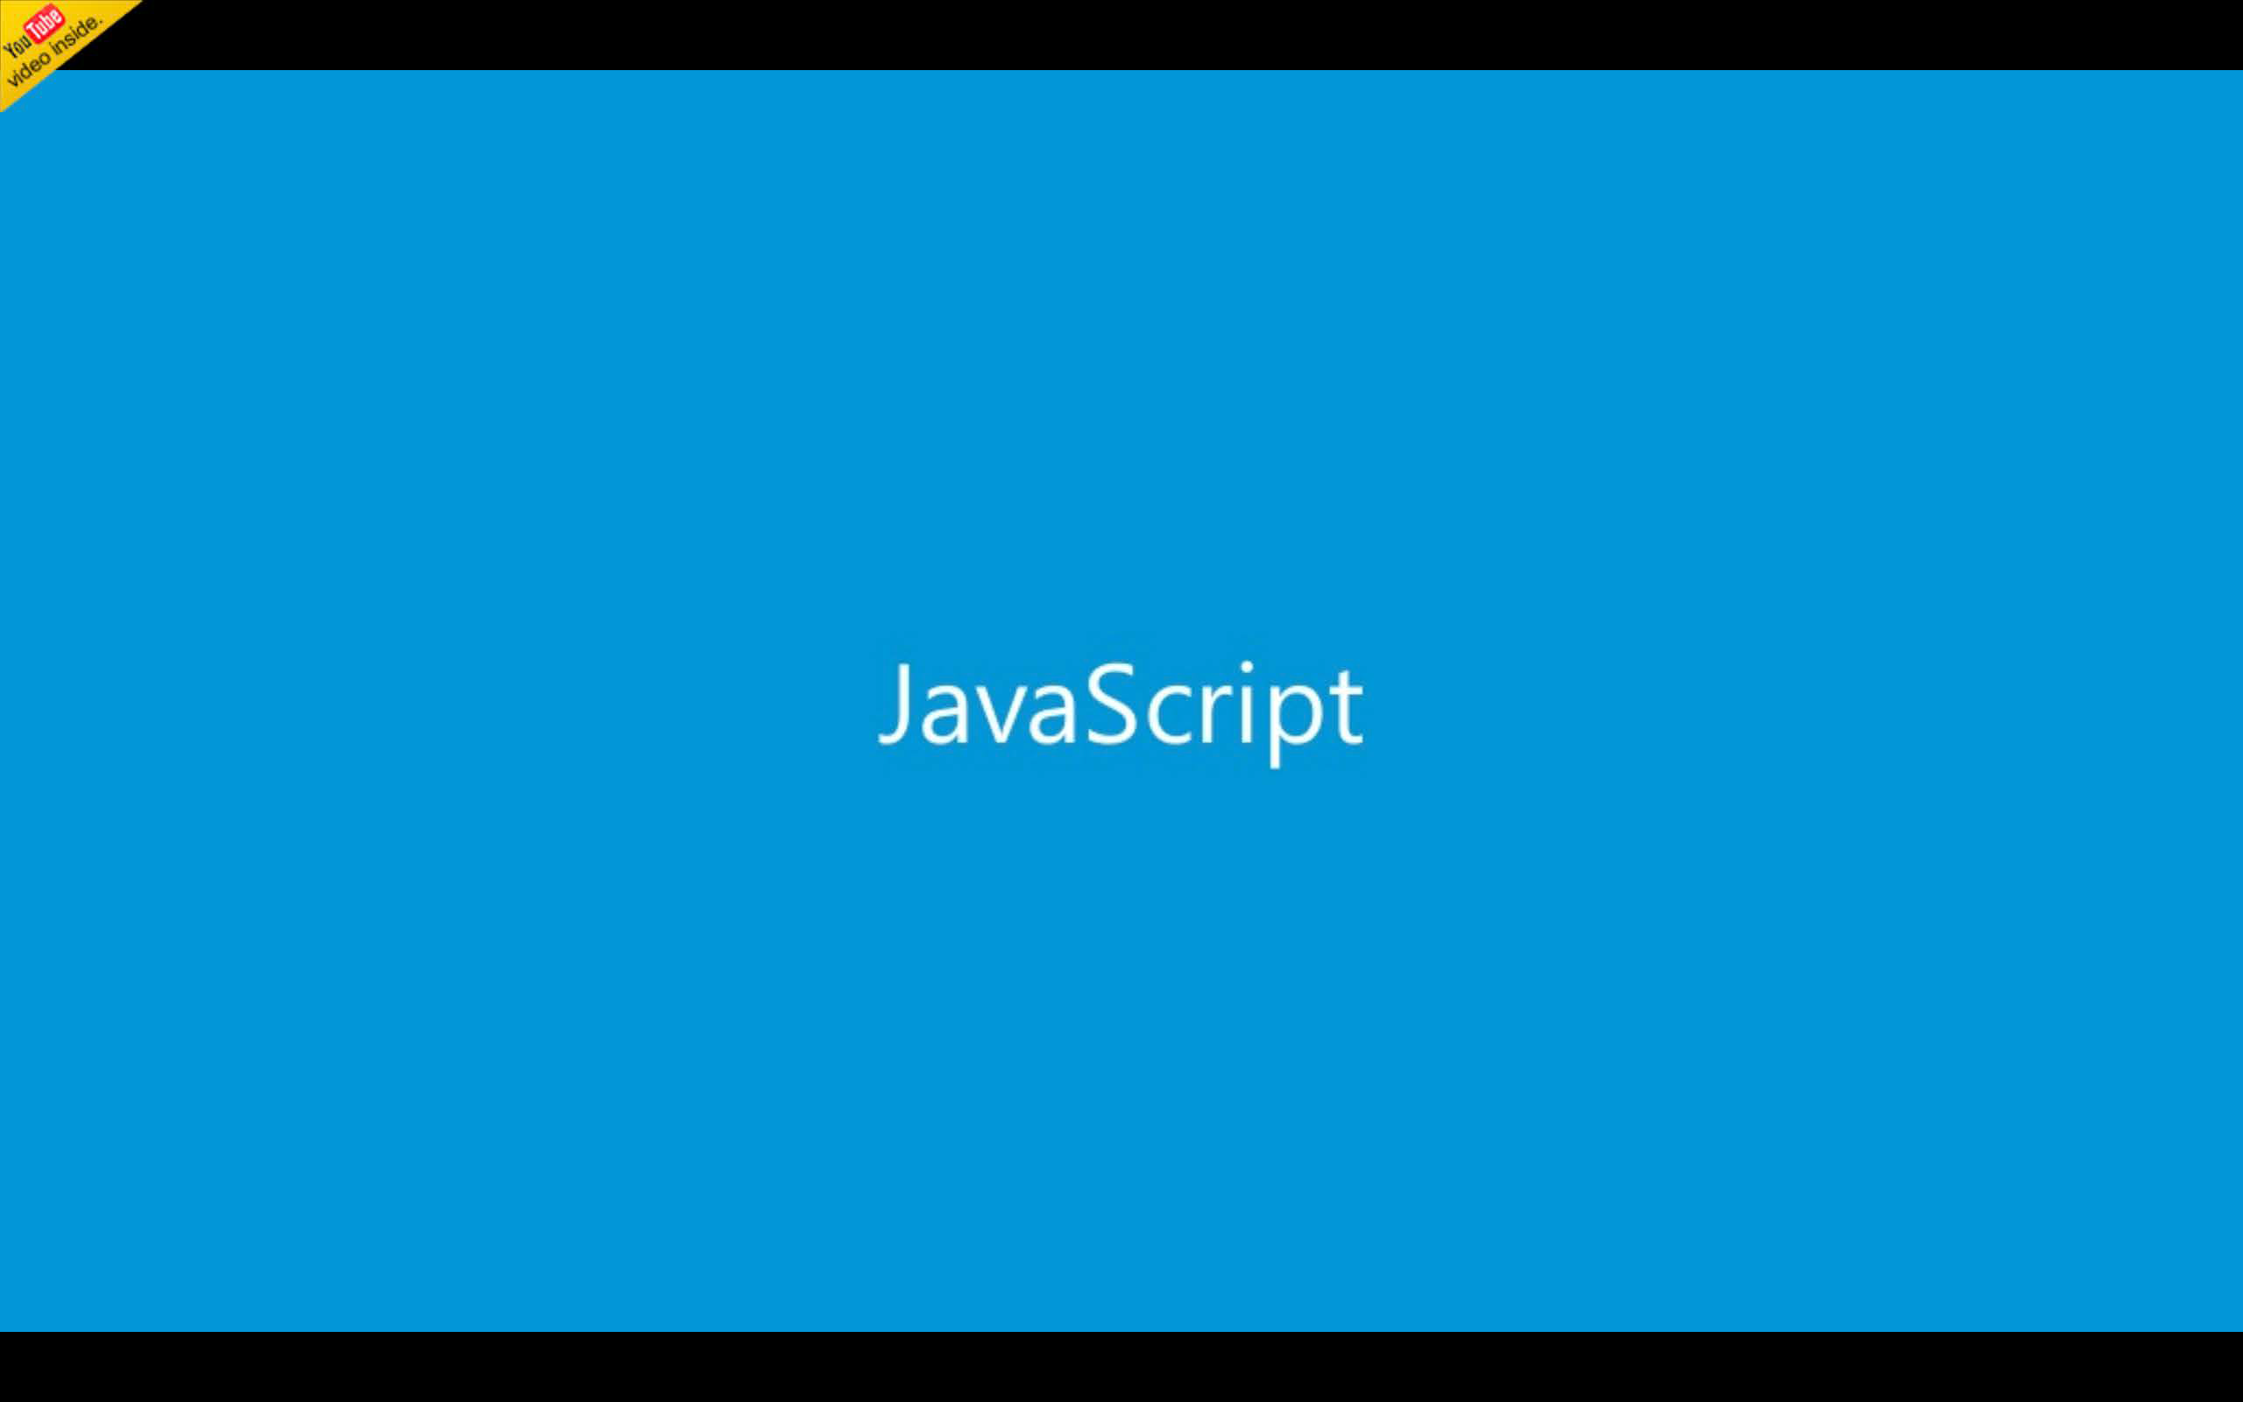

Slide 8
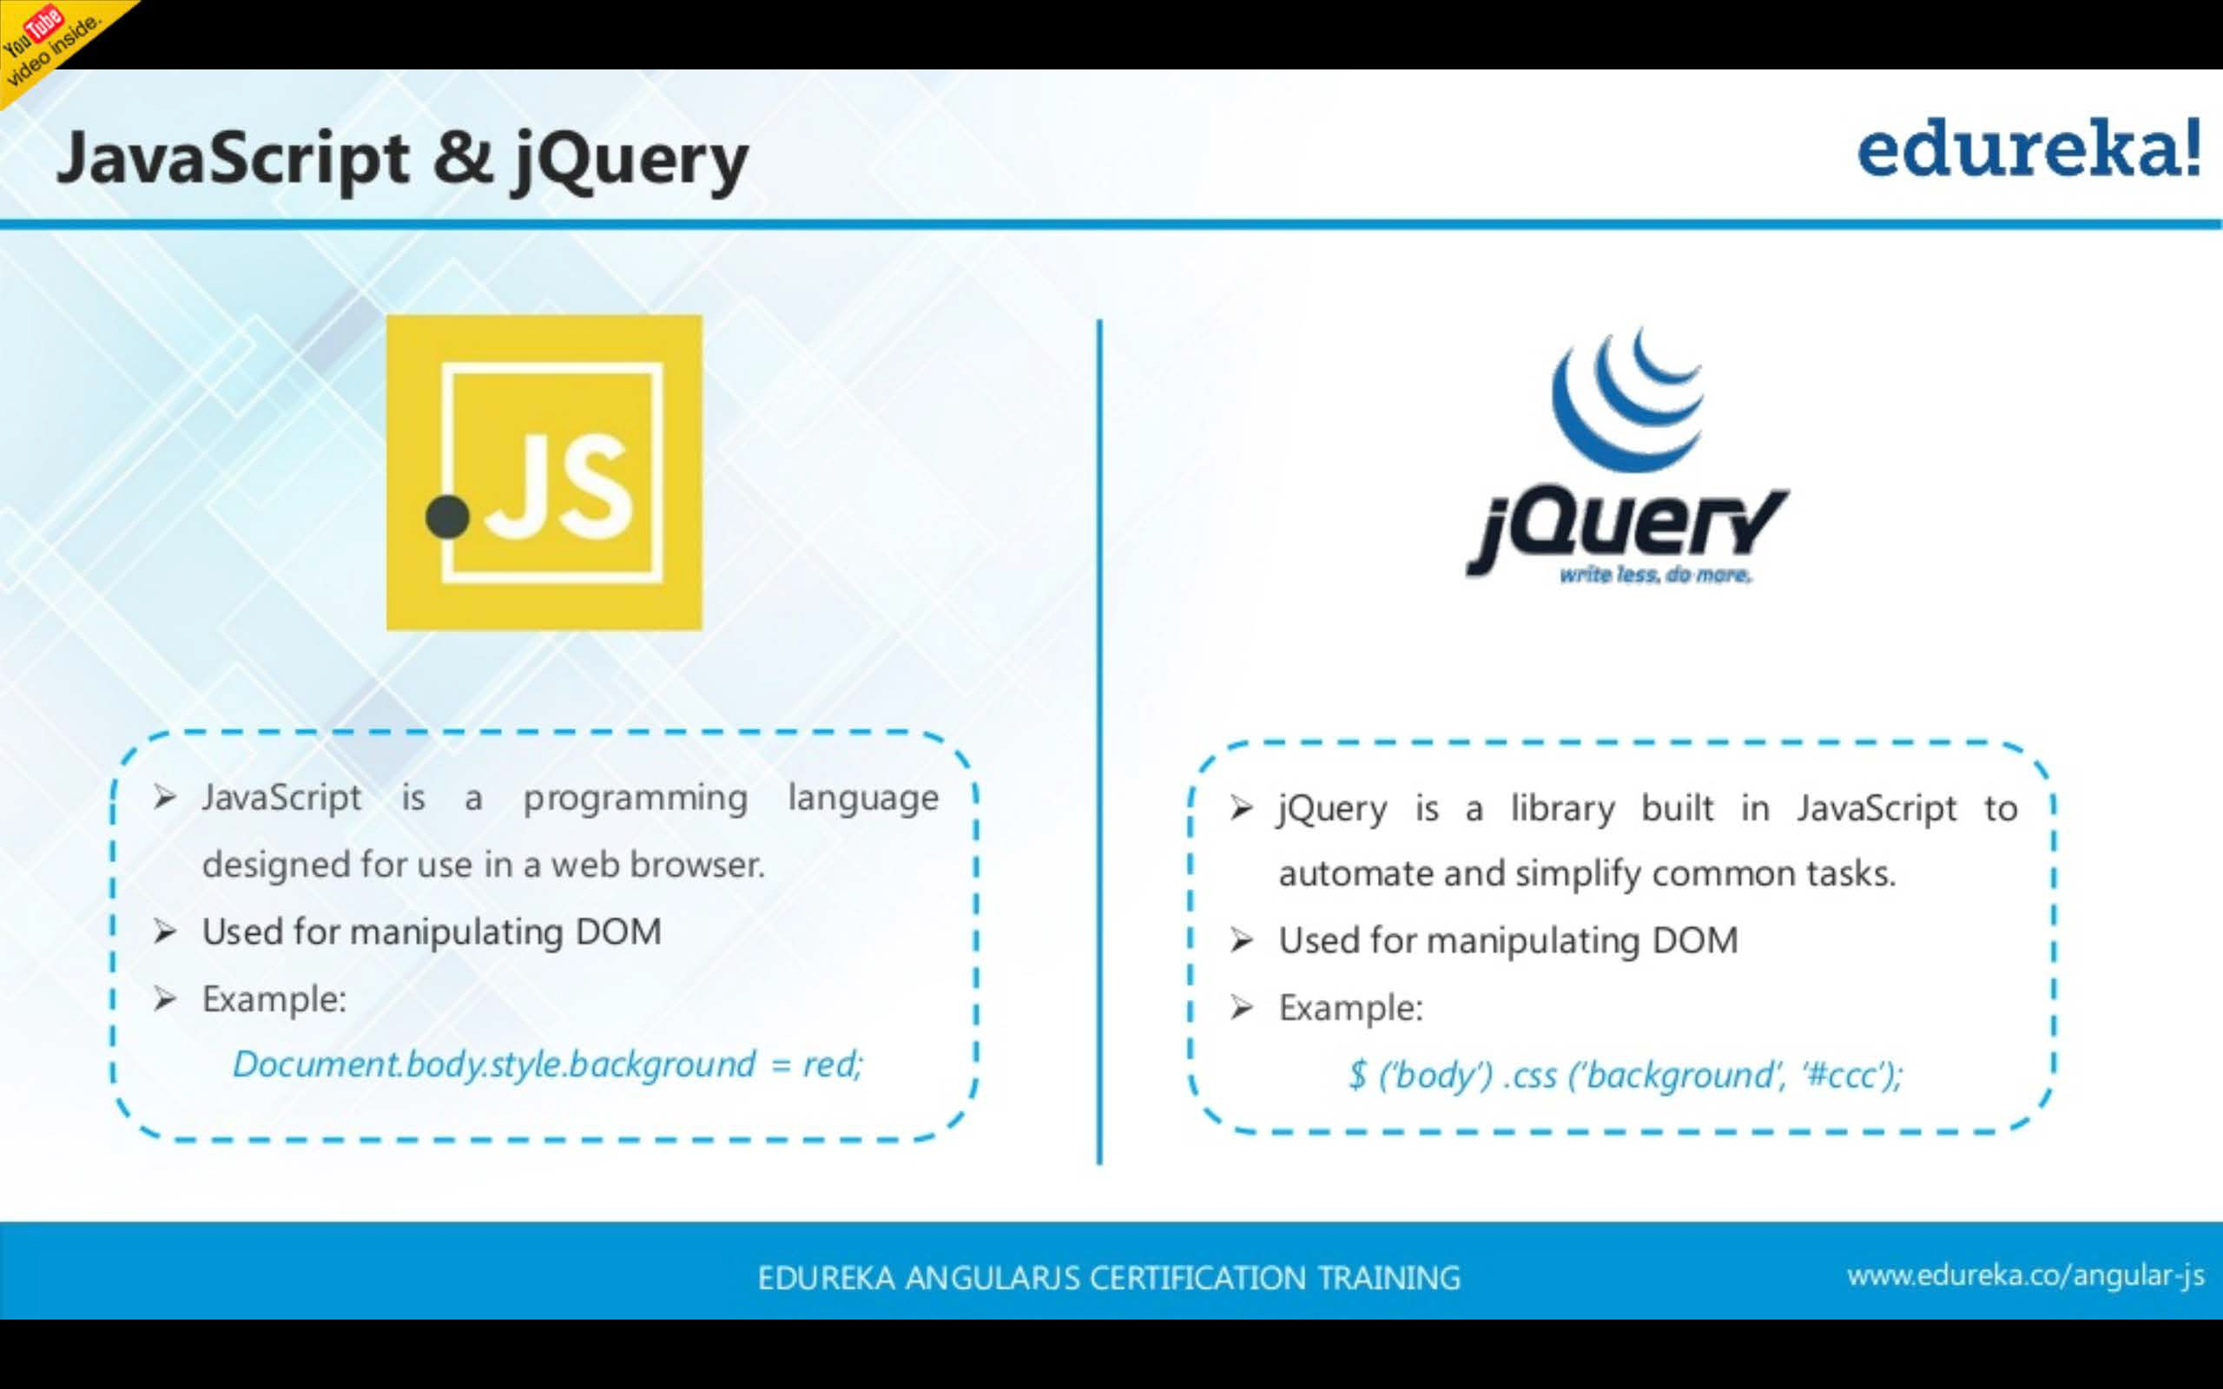

Slide 9


Slide 10
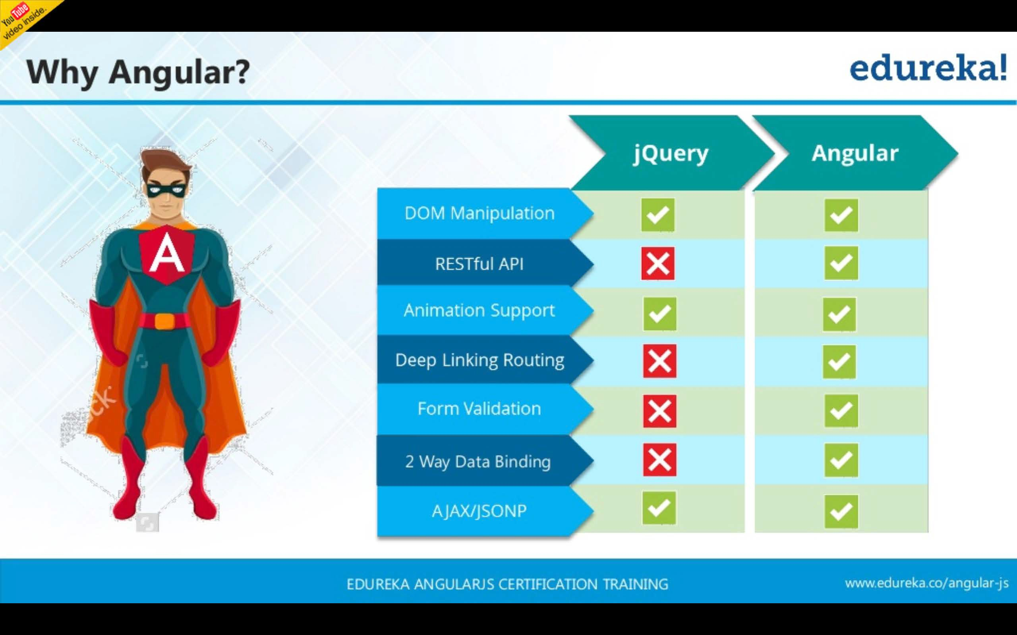

Slide 11


Slide 12
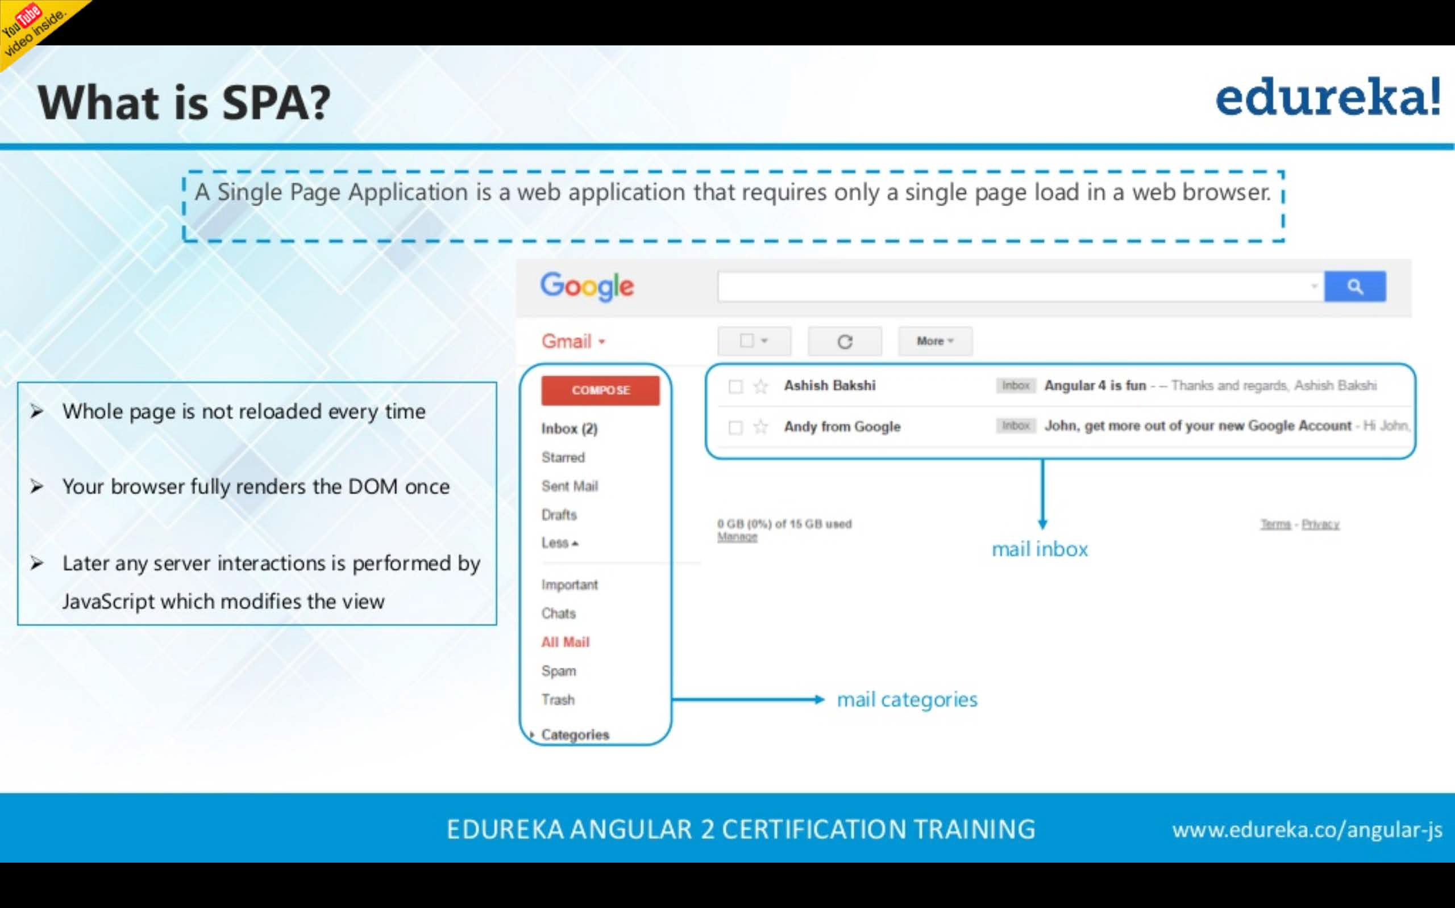

Slide 13
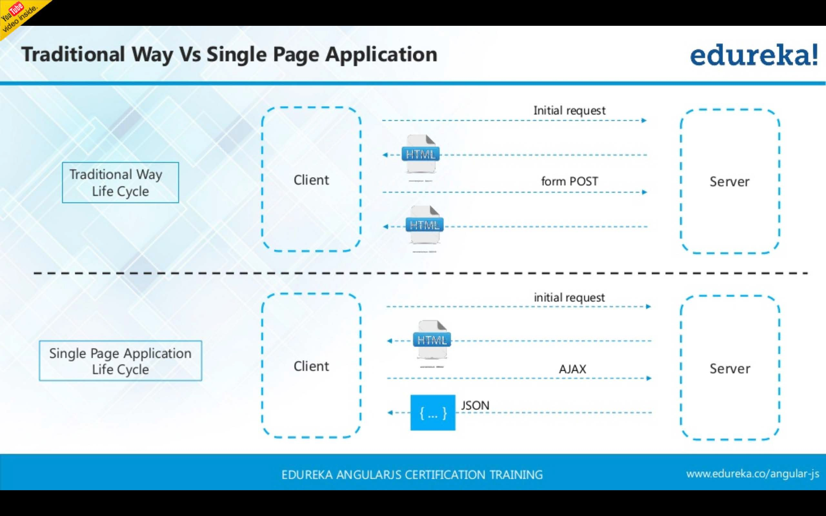

Slide 14
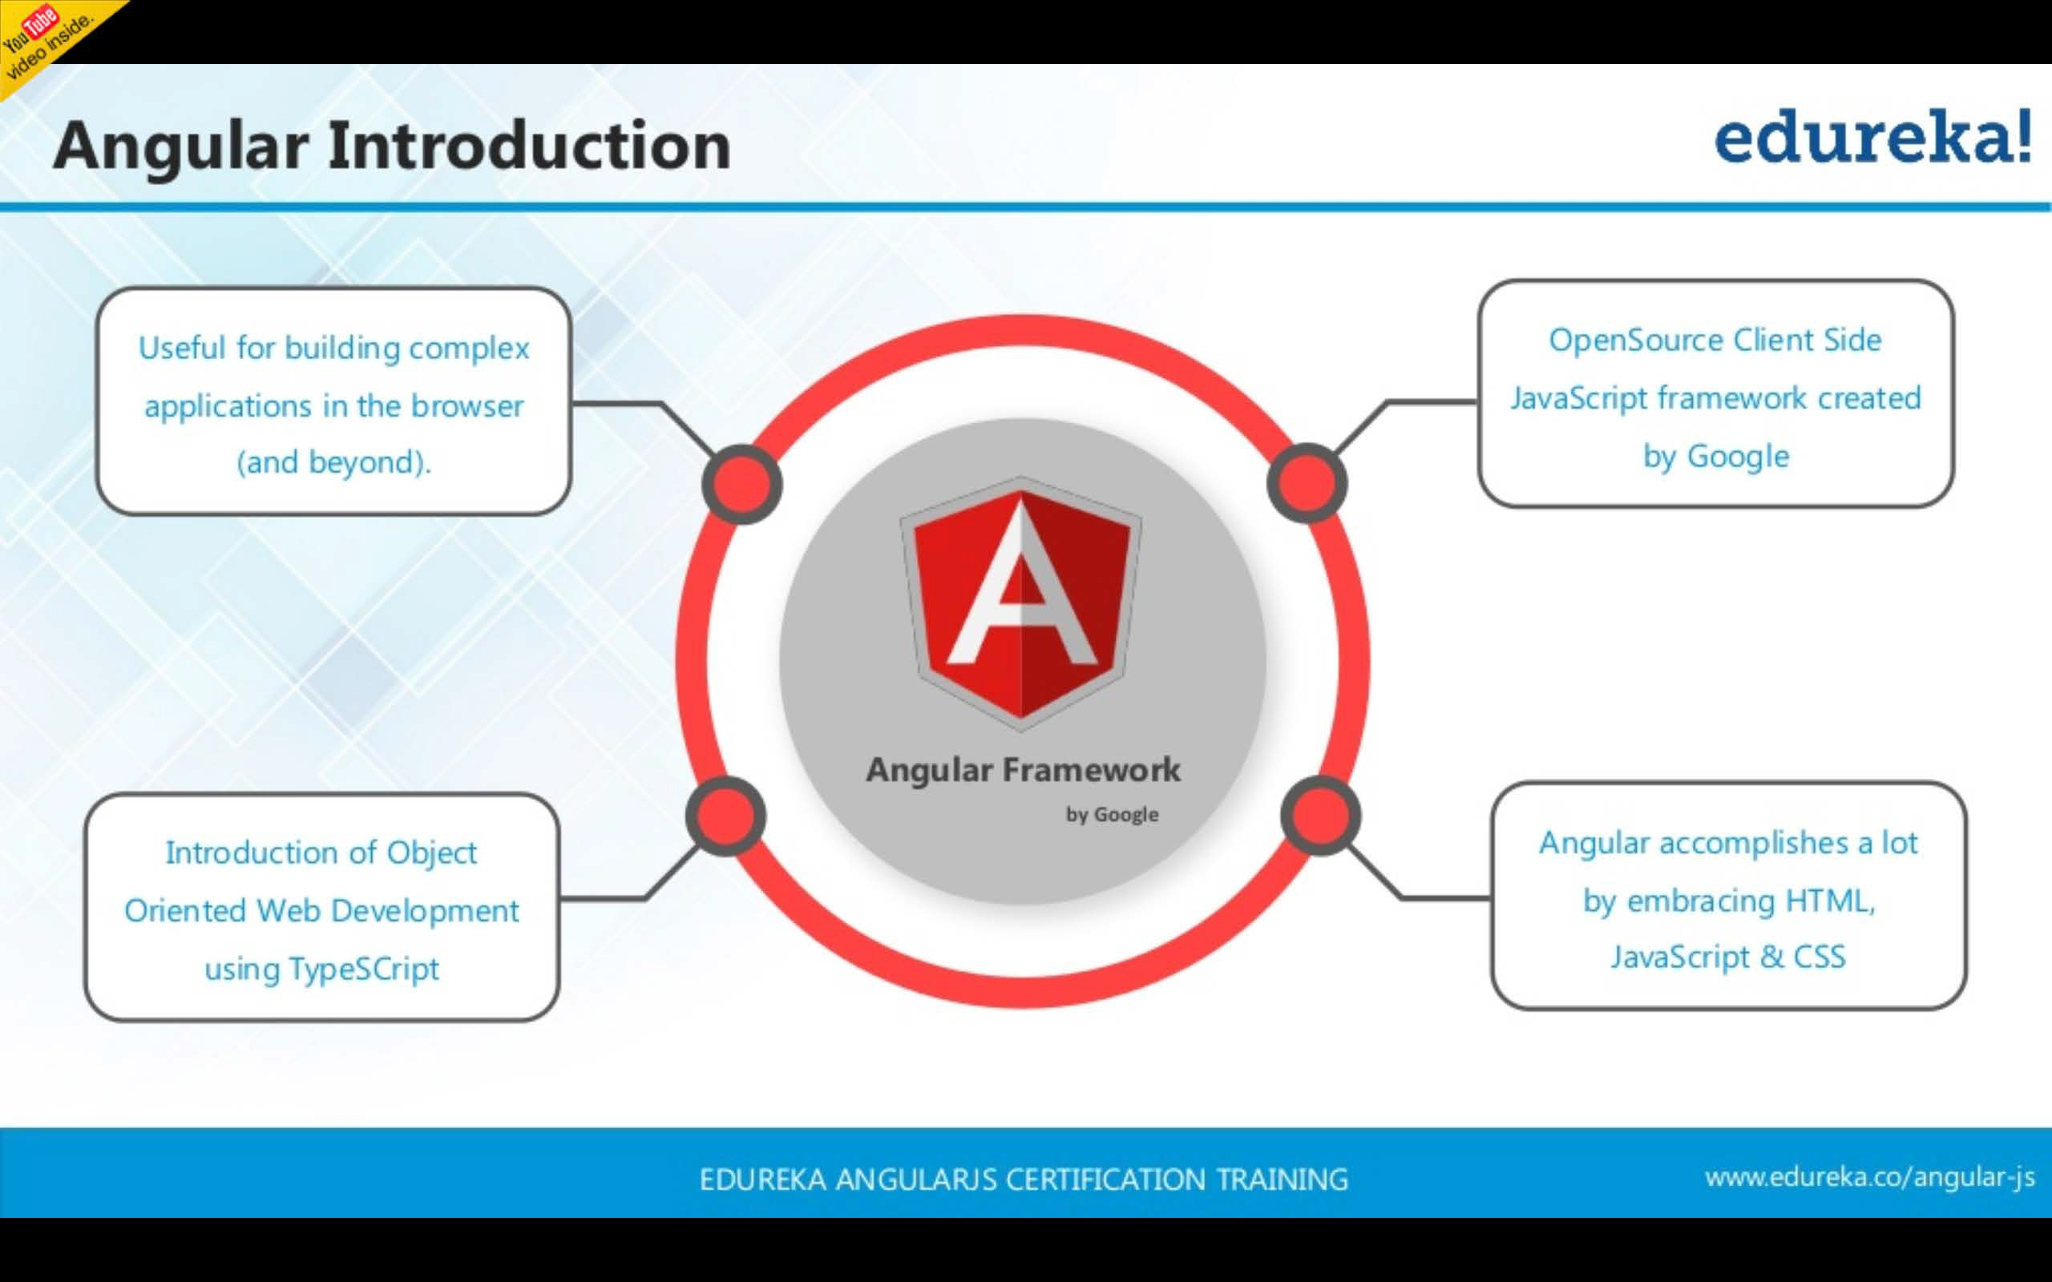

Slide 15
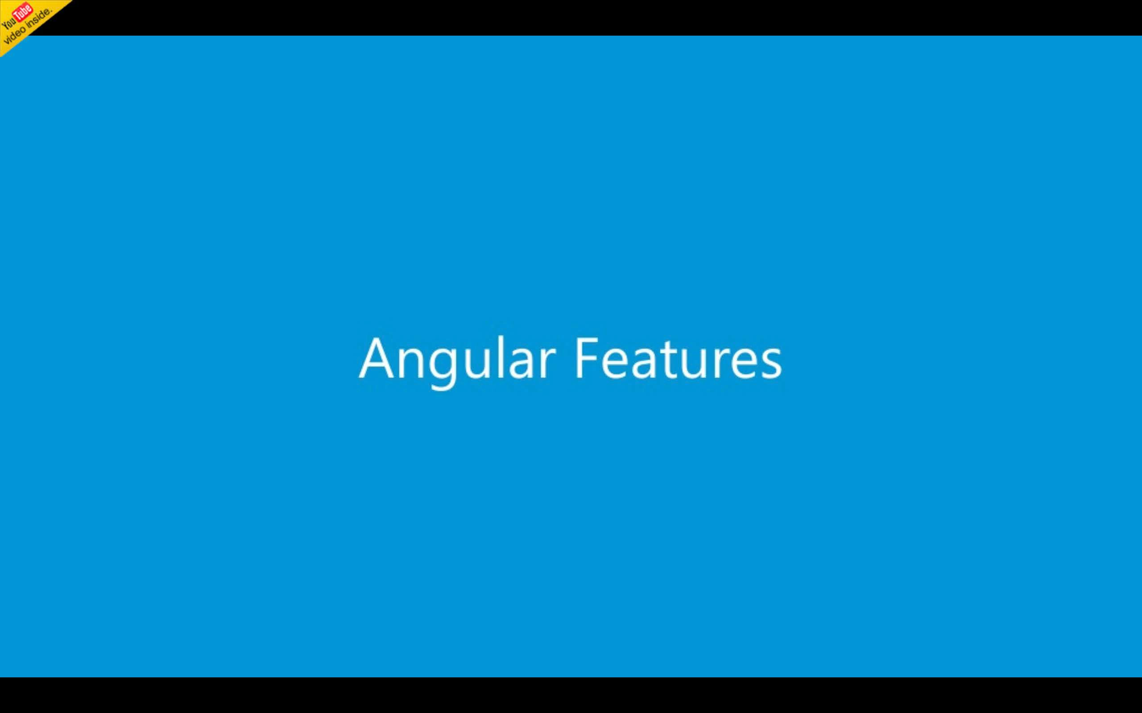

Slide 16
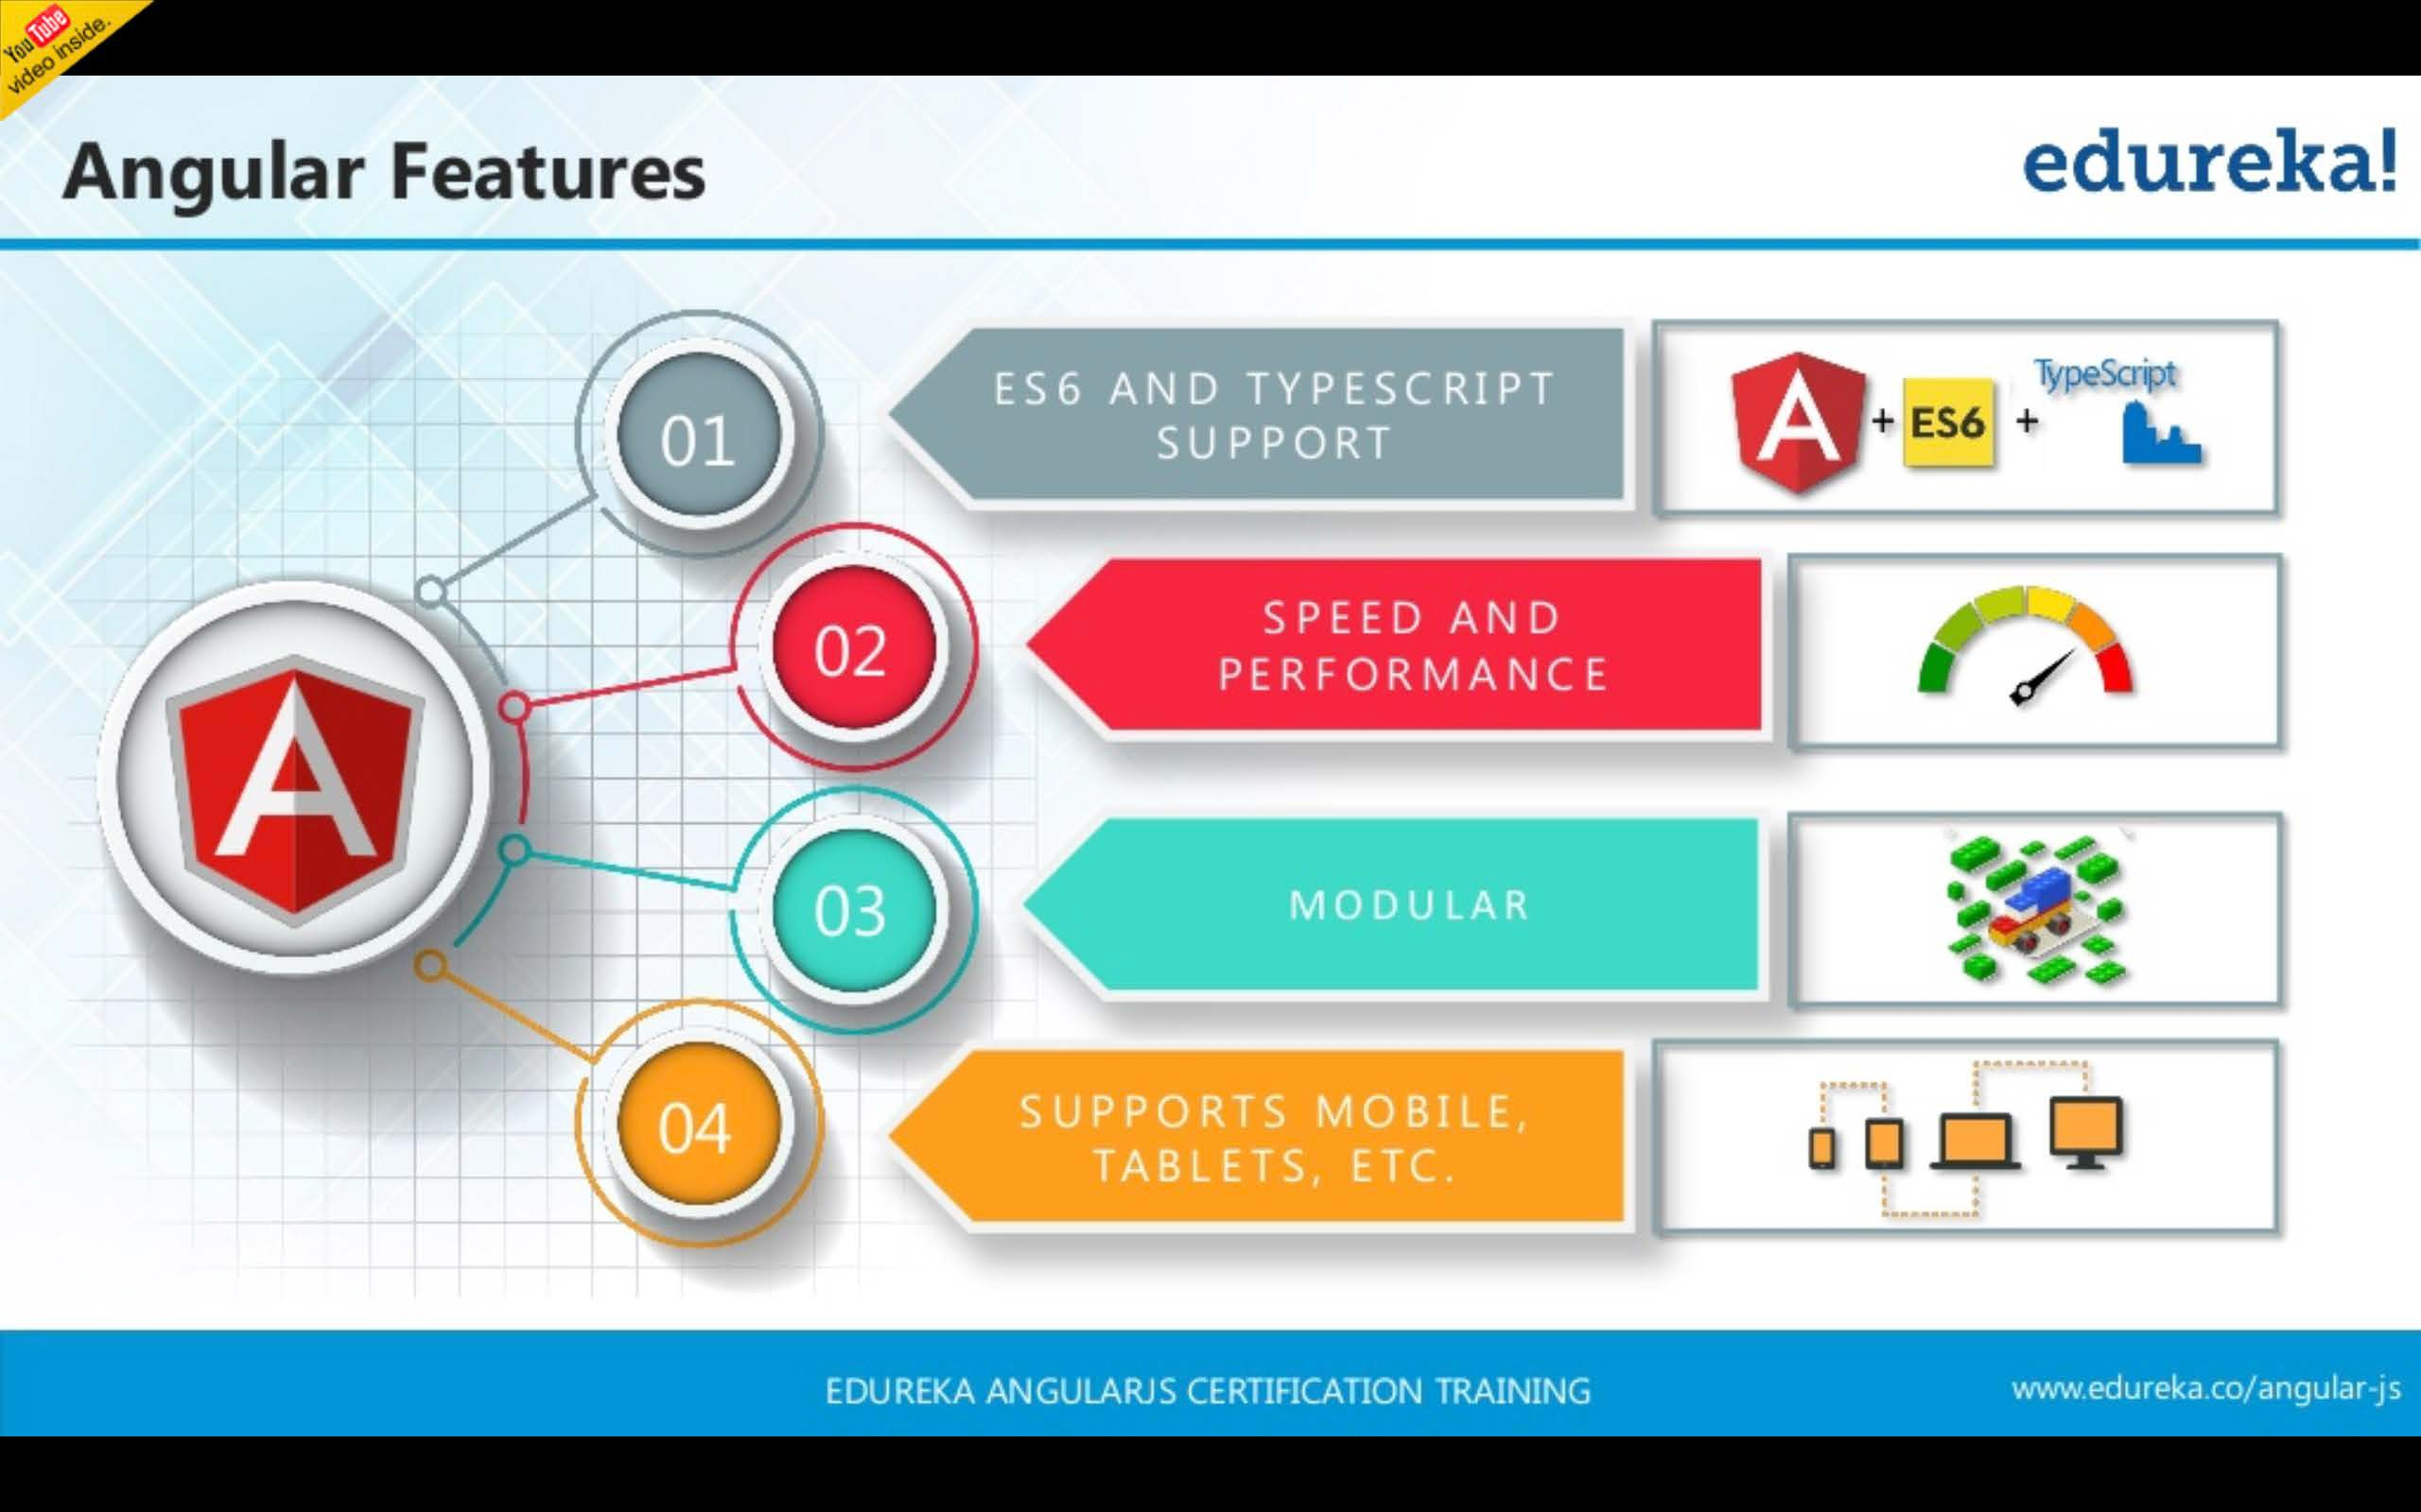

Slide 17
Angular project Structure
Application Starting Order
main.ts
Main.ts file is entry point of our application.
Main.ts file bootstrap app.module.ts file.
app.module.ts
This file bootstraps app.component.ts.
app.component.ts
It renders app.component.html.
app.component.html
Final HTML template

Slide 18
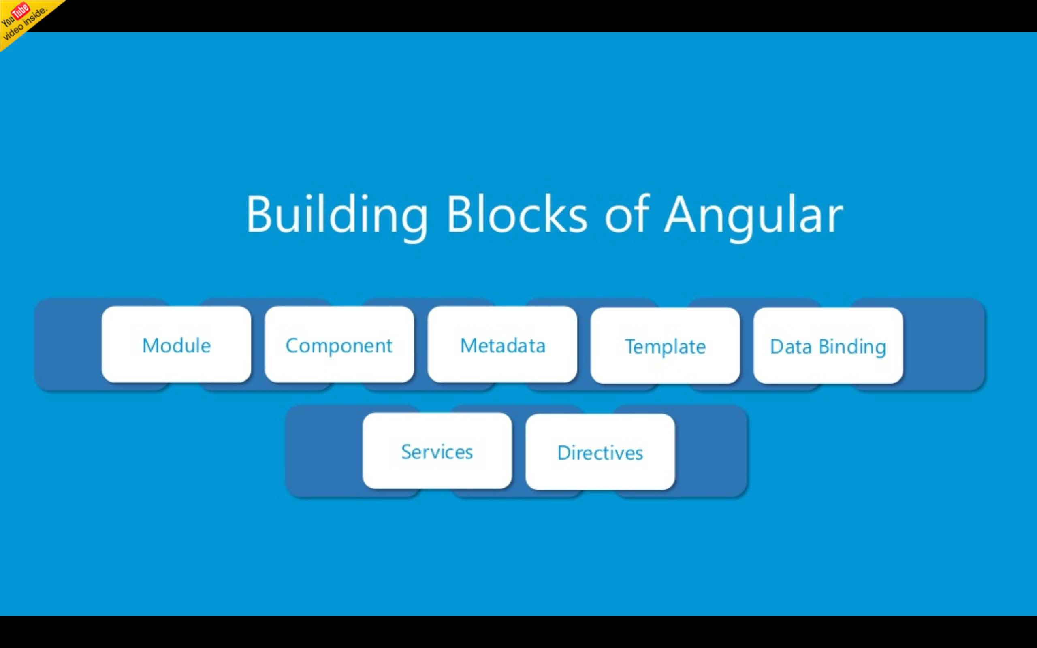

Slide 19
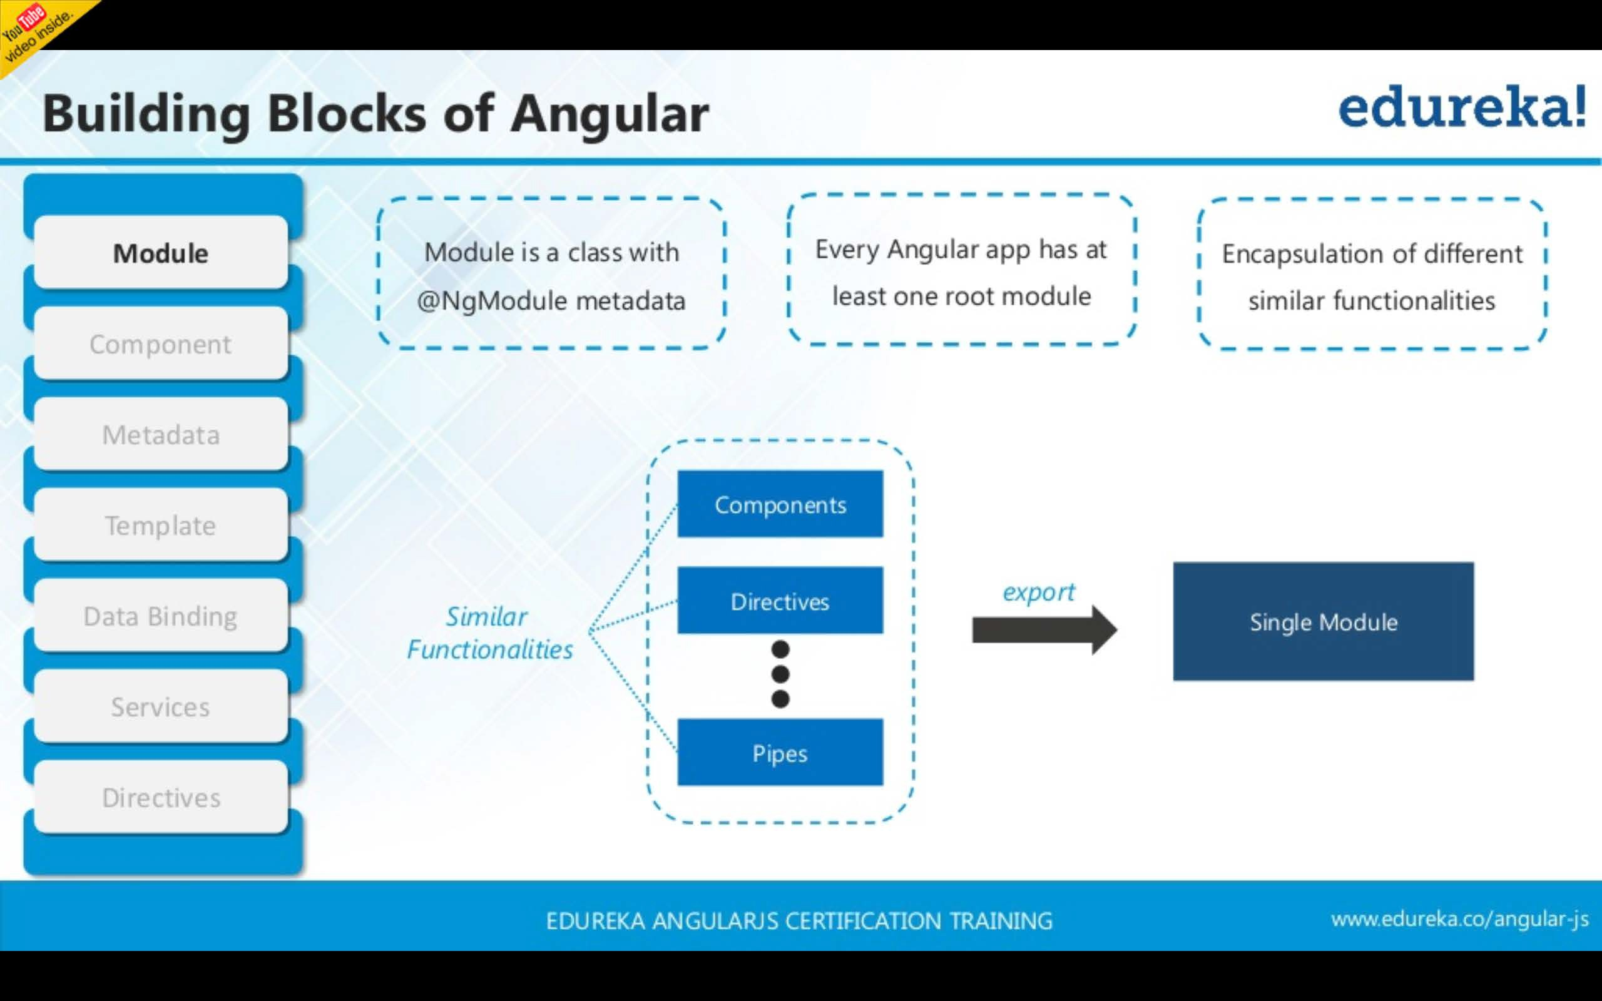

Slide 20
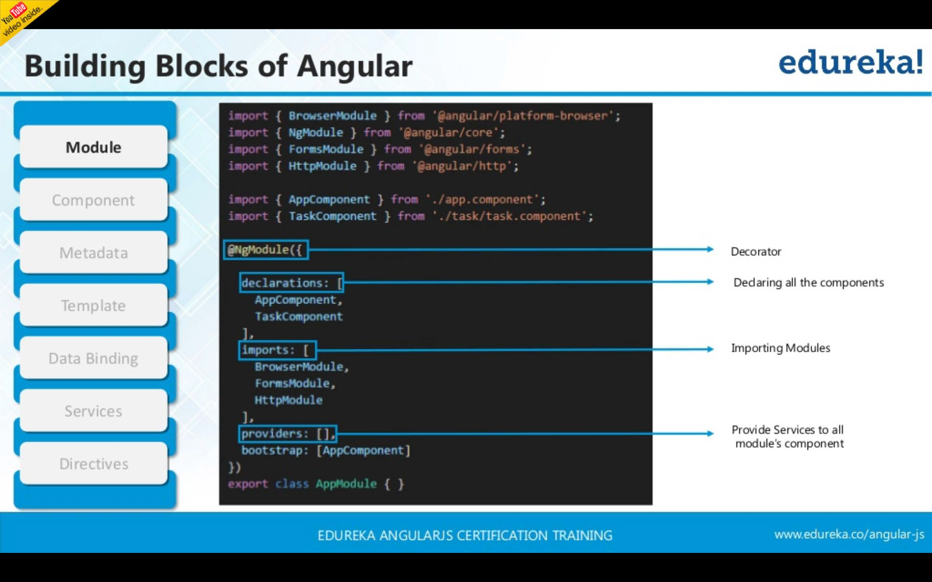

Slide 21
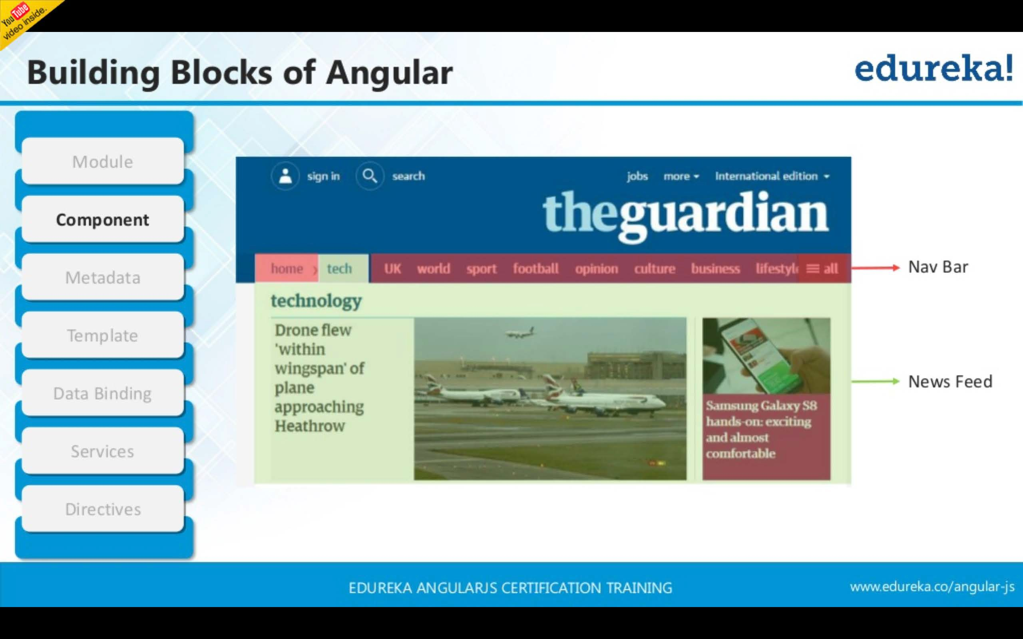

Slide 22
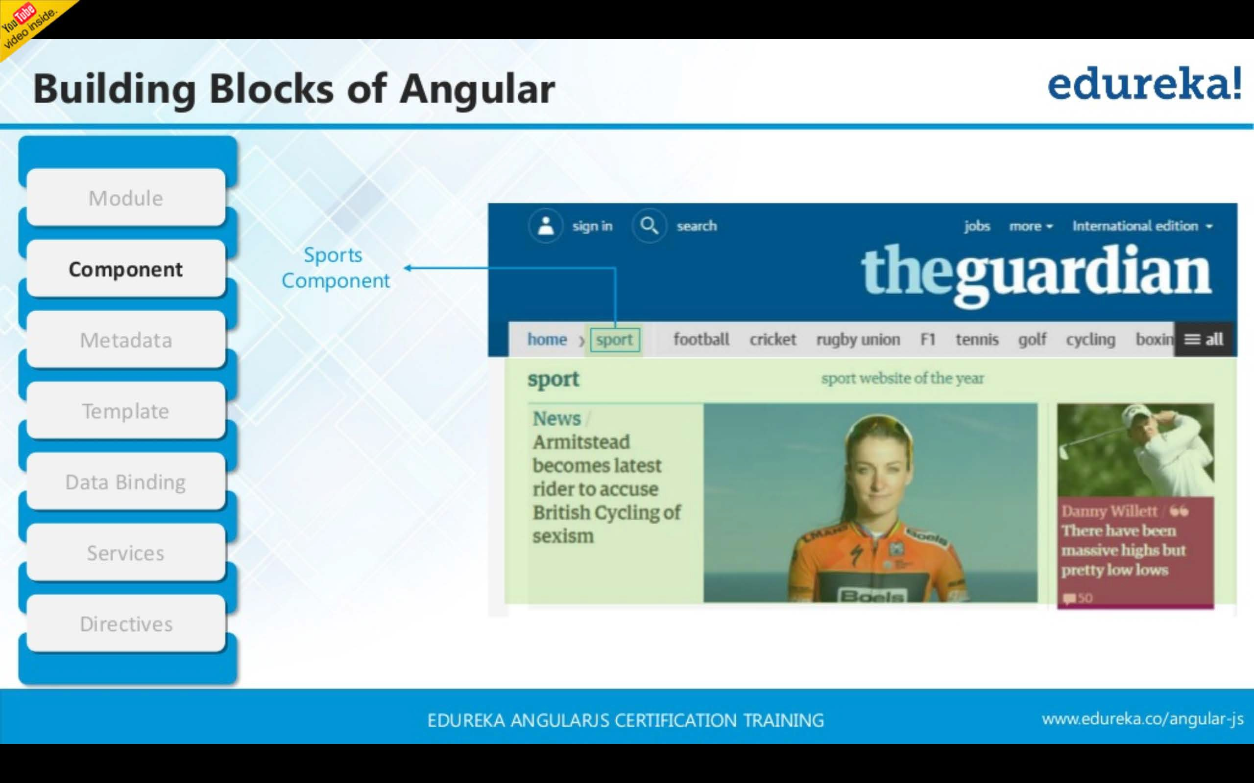

Slide 23
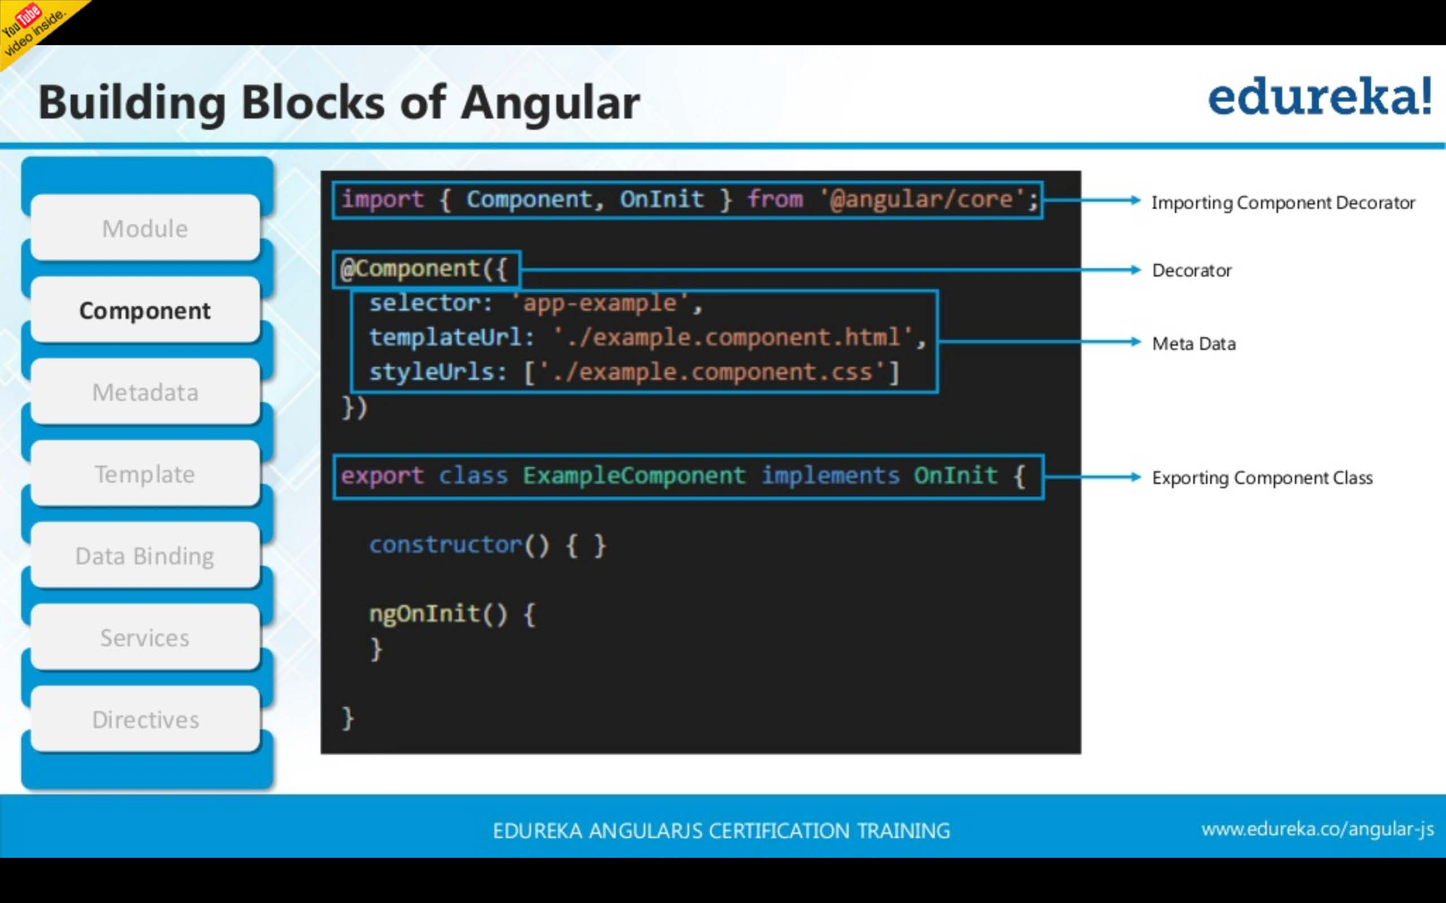

Slide 24




Components
Components are a logical piece of code for Angular application.
A Component consists of the following −
 |  |  | Component
Template |  |  | Class |  |  | Metadata
Template is used to render the view for the application.
This contains the HTML that
needs to be rendered in the application.
This is like a class defined in any language such as C#.
This has the code which is used to support the view.
It is defined in TypeScript.
This has the extra data defined for the Angular class.
It is defined with a decorator.

Slide 25
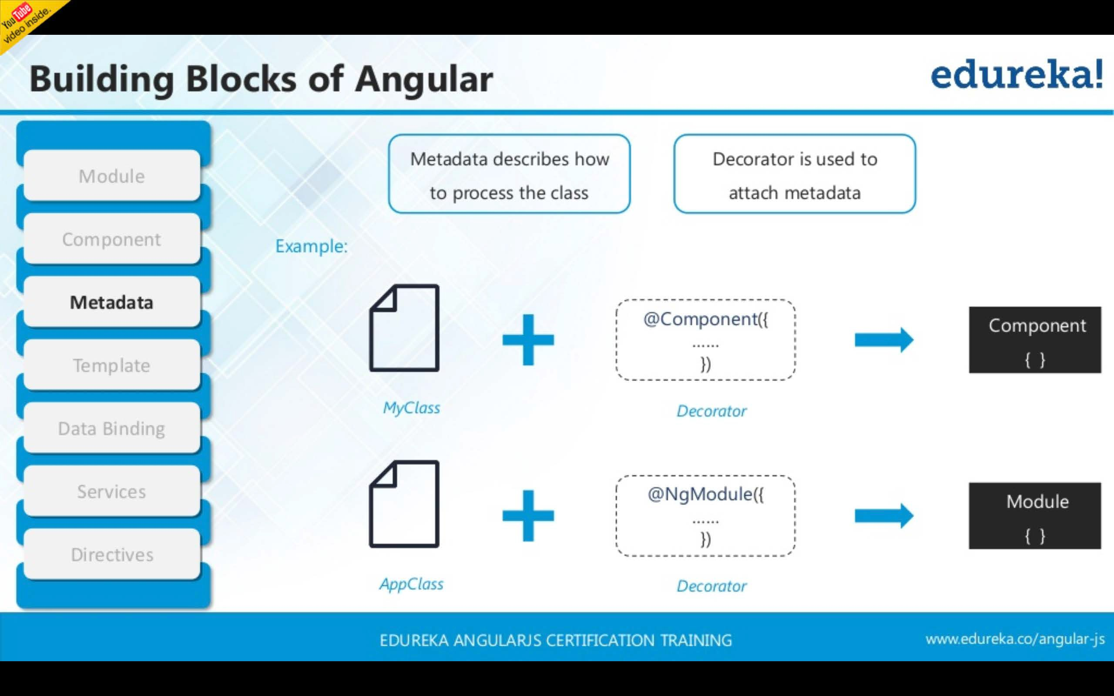

Slide 26
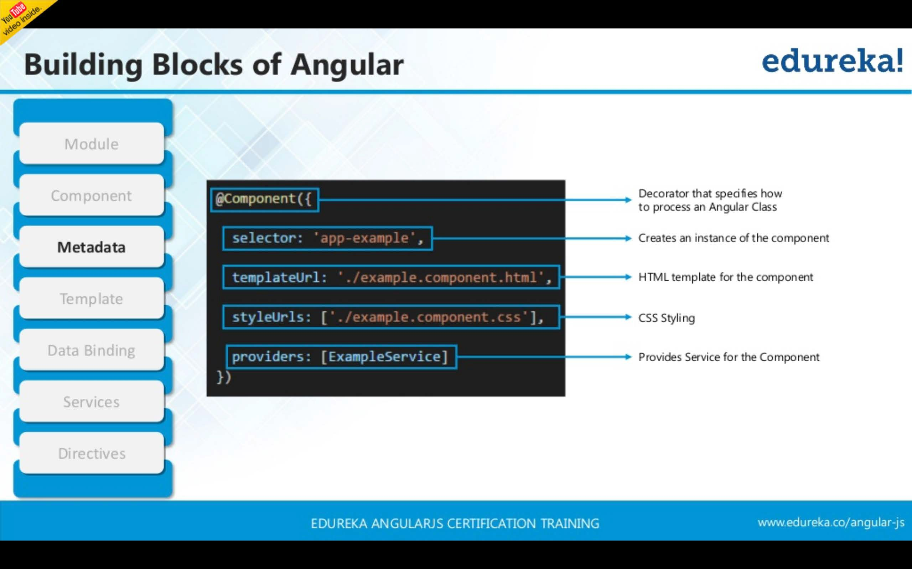

Slide 27
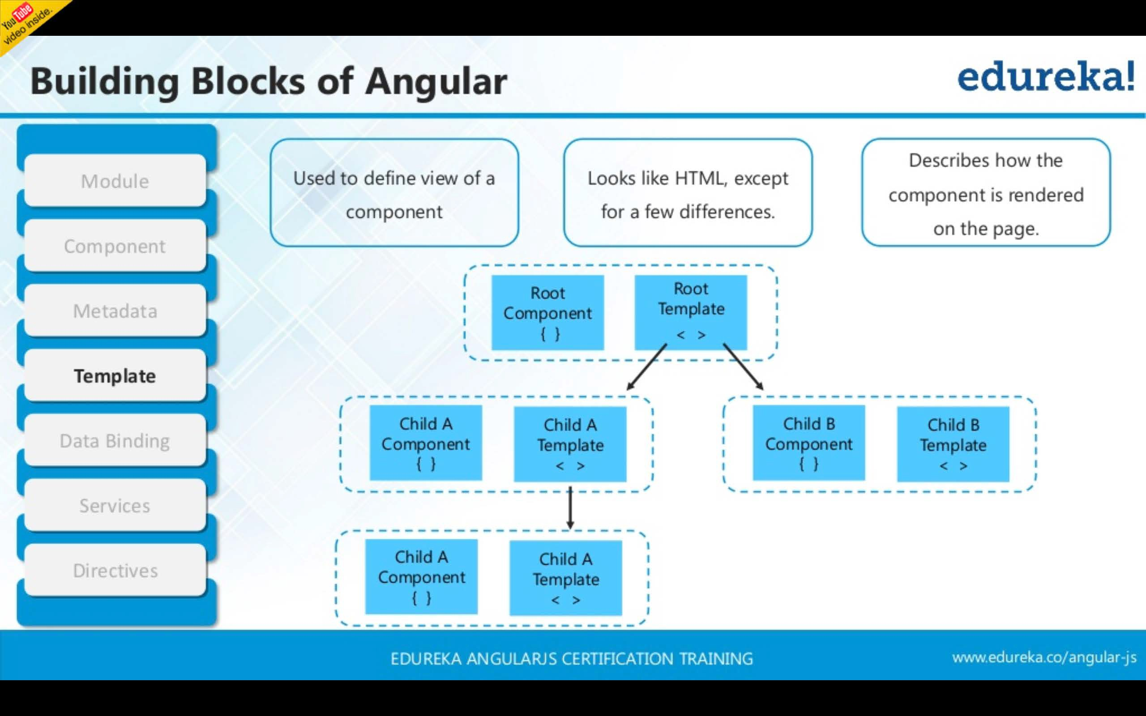

Slide 28
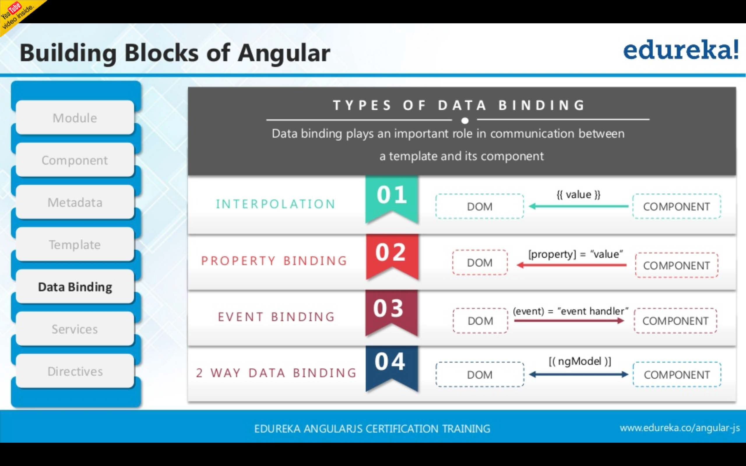

Slide 29
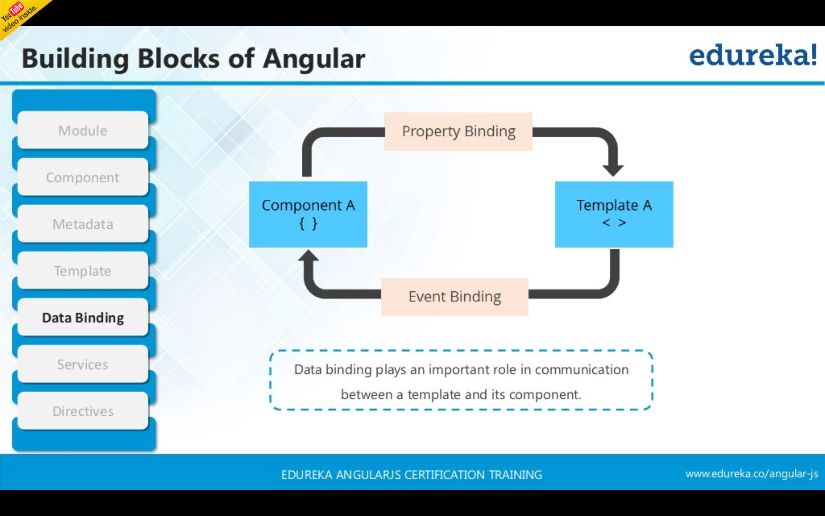

Slide 30
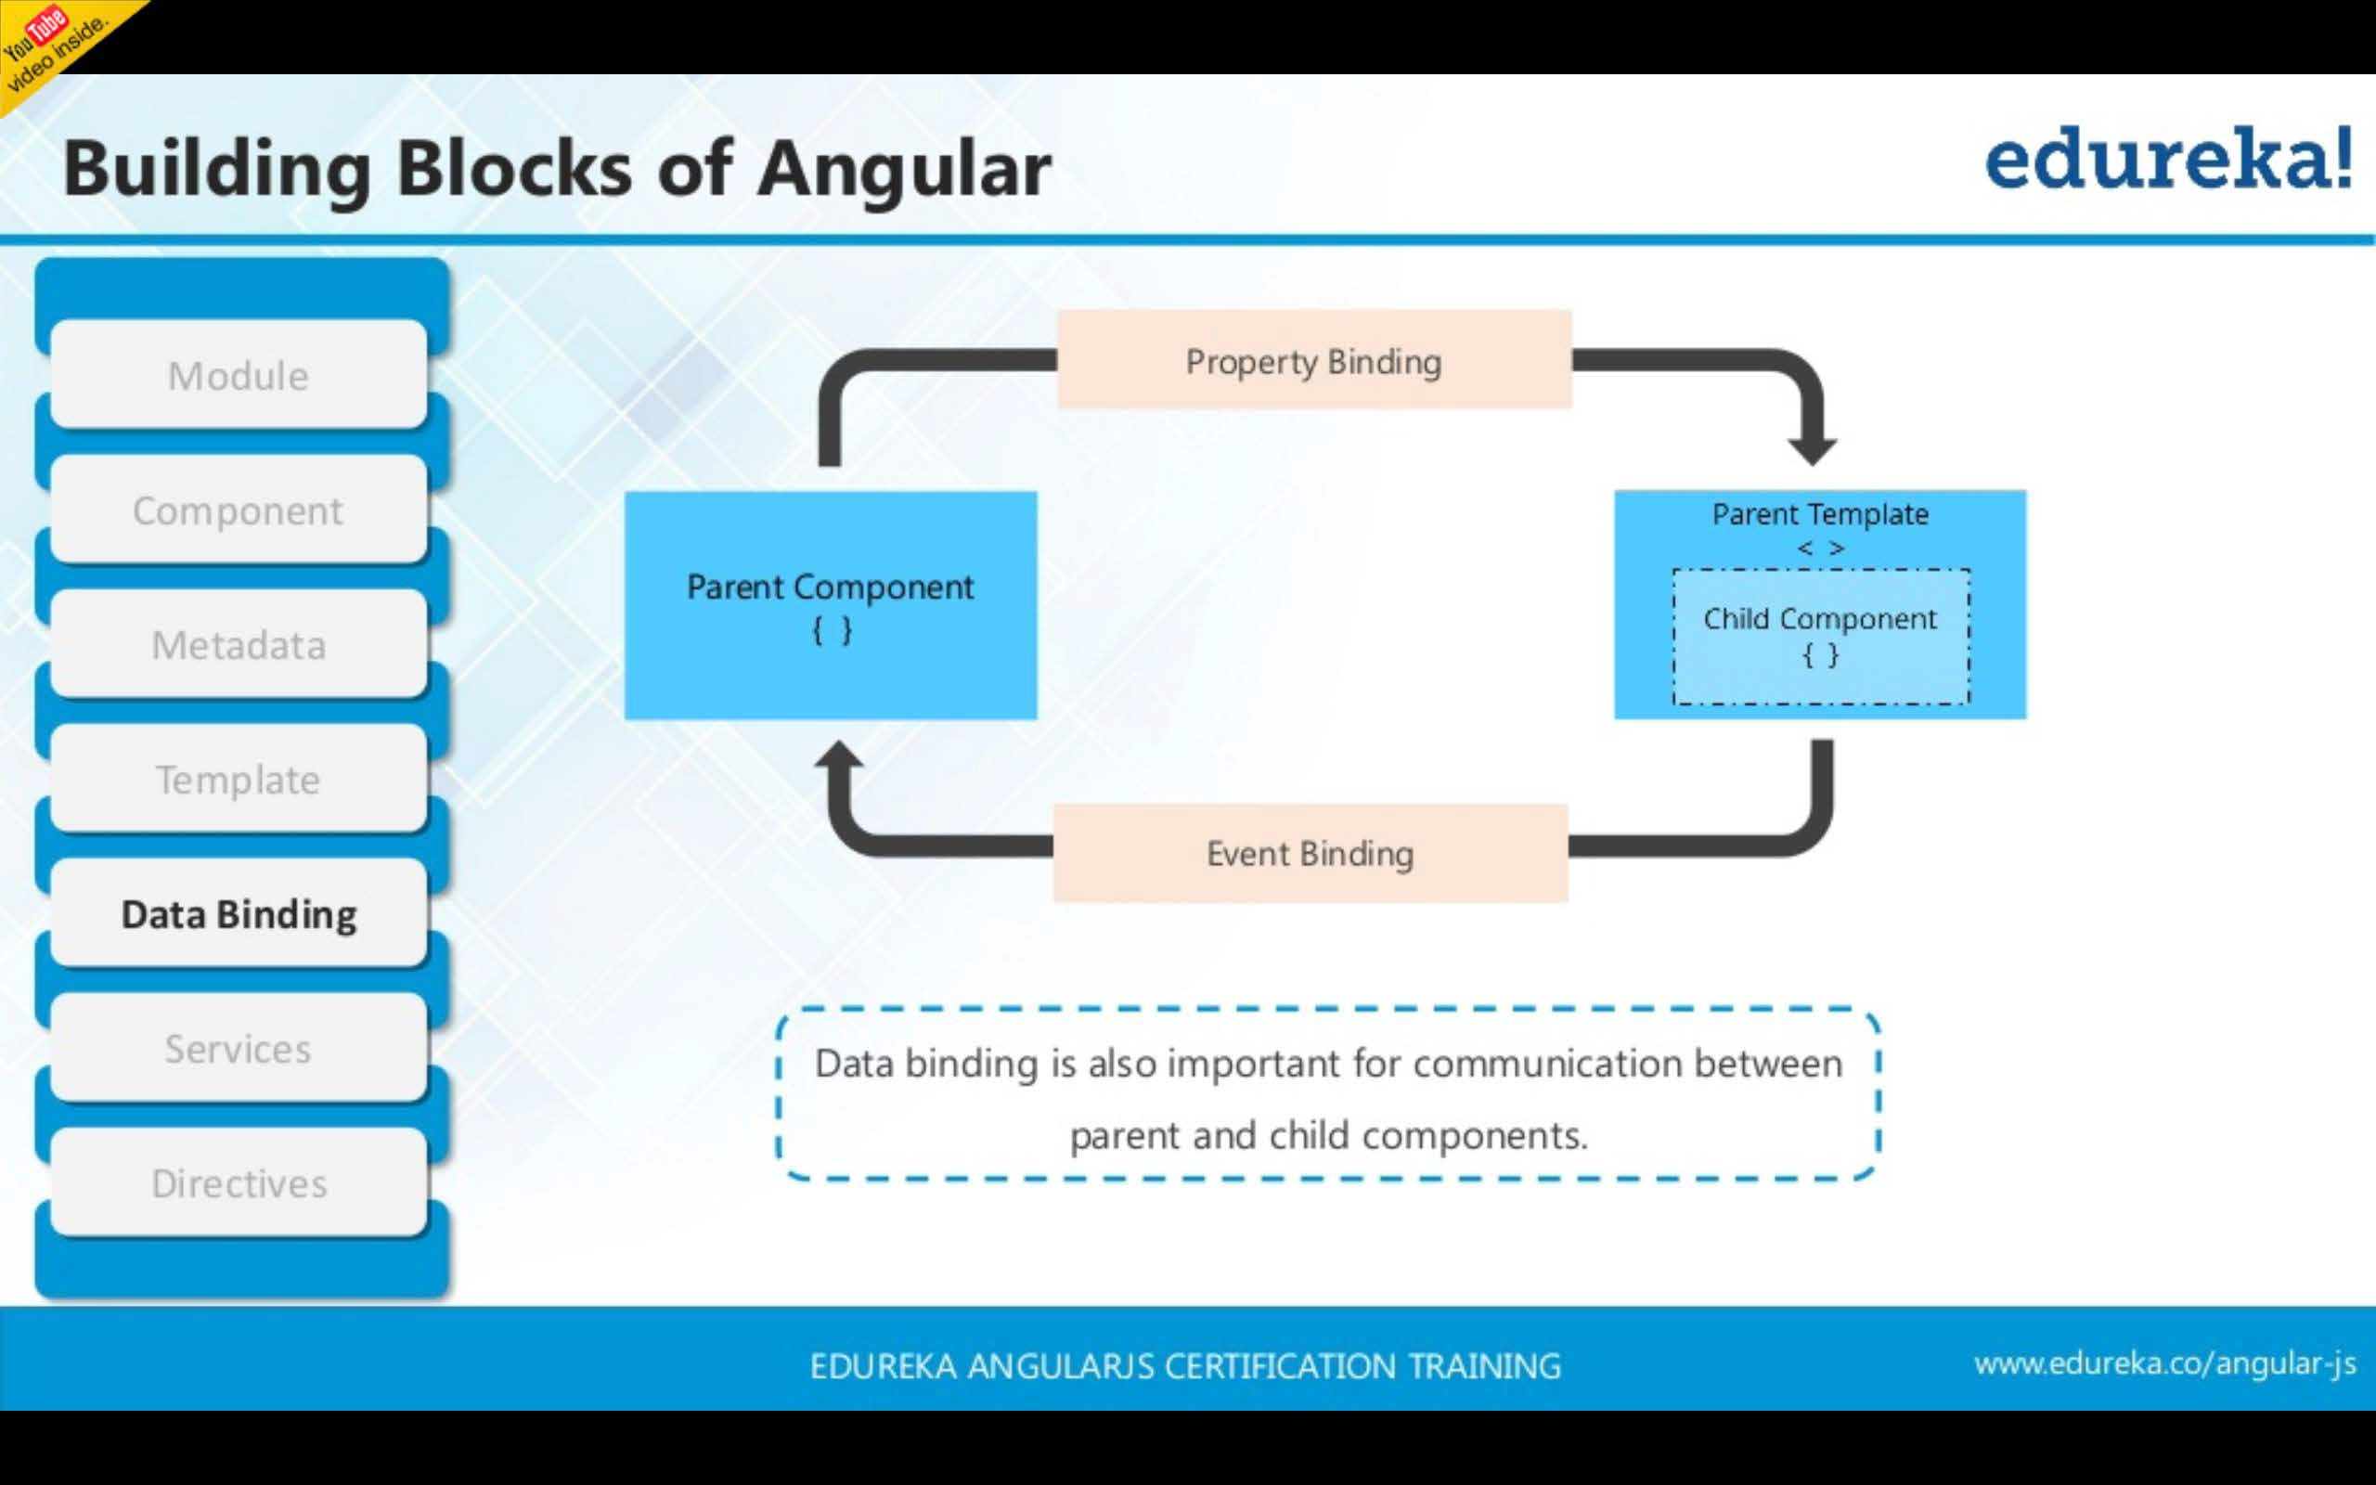

Slide 31
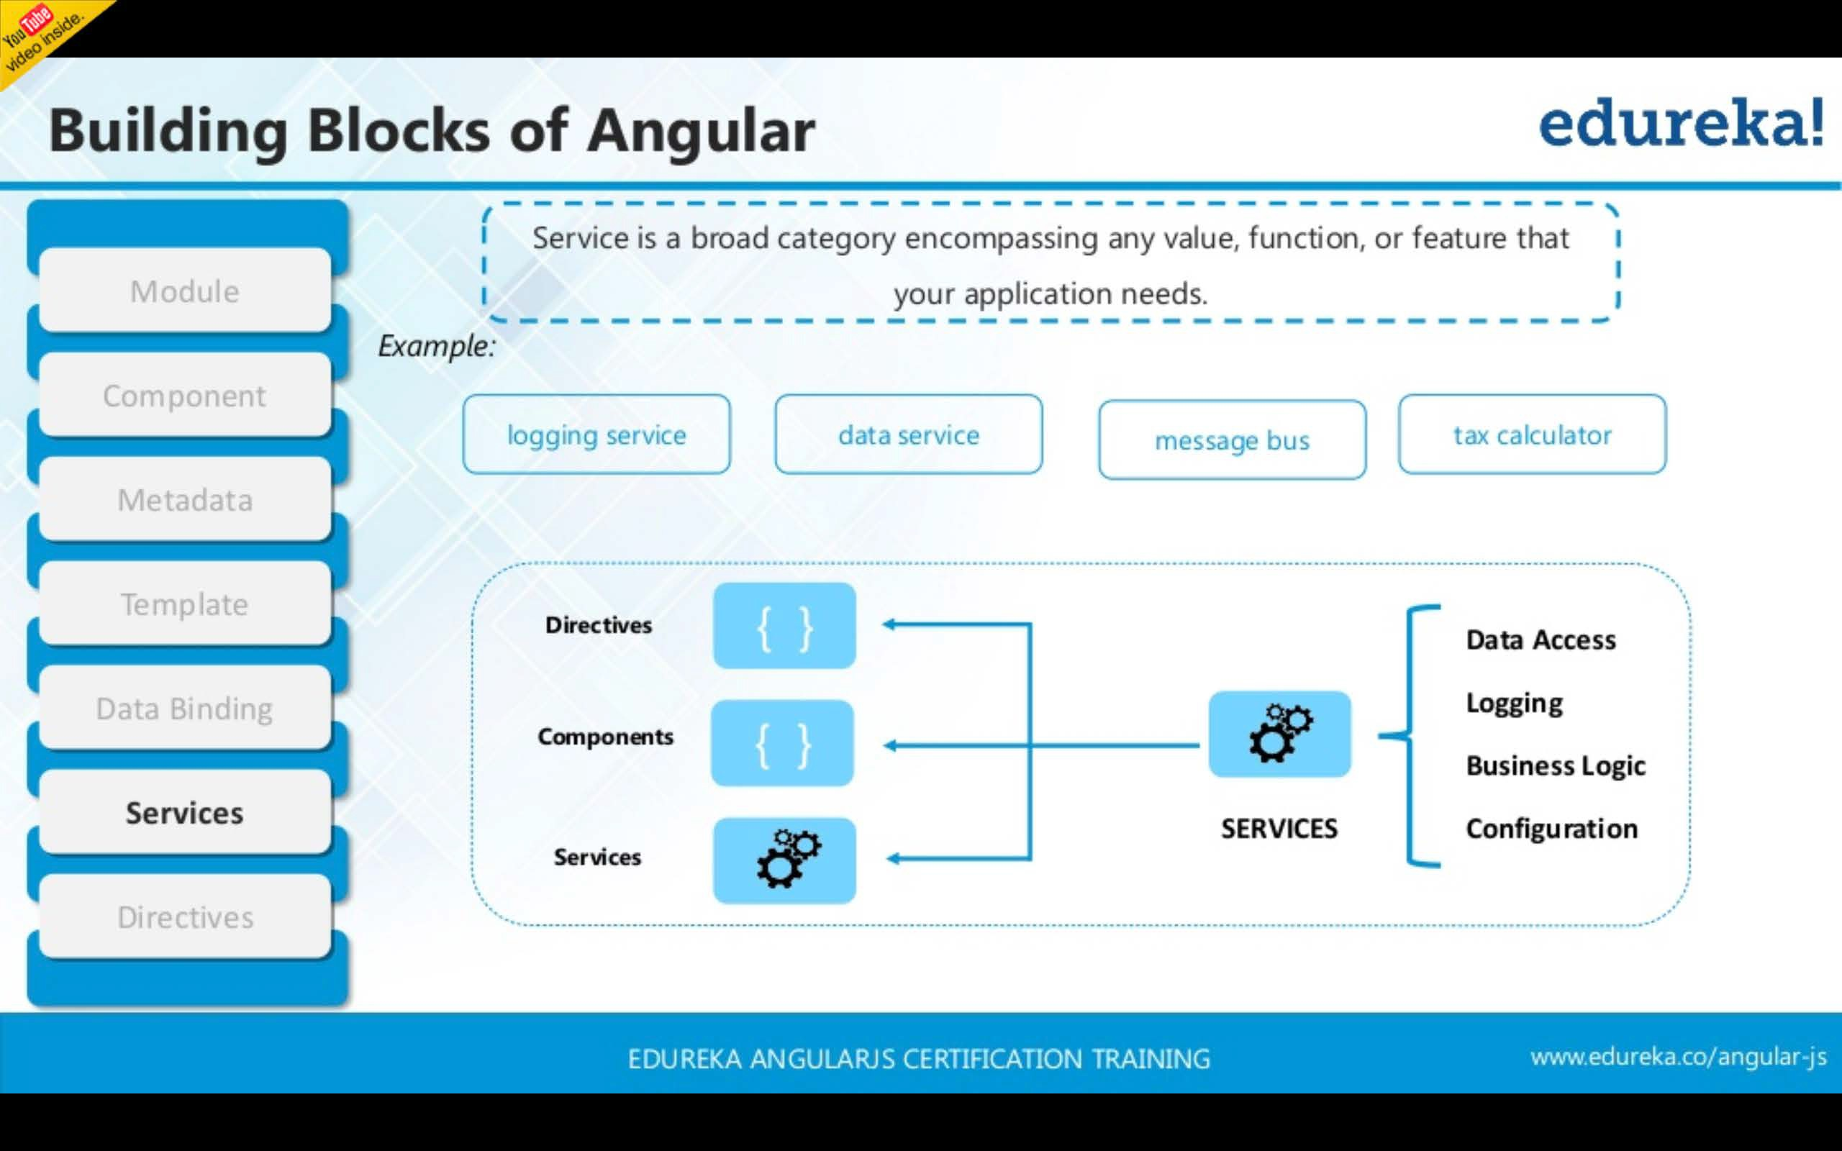

Slide 32
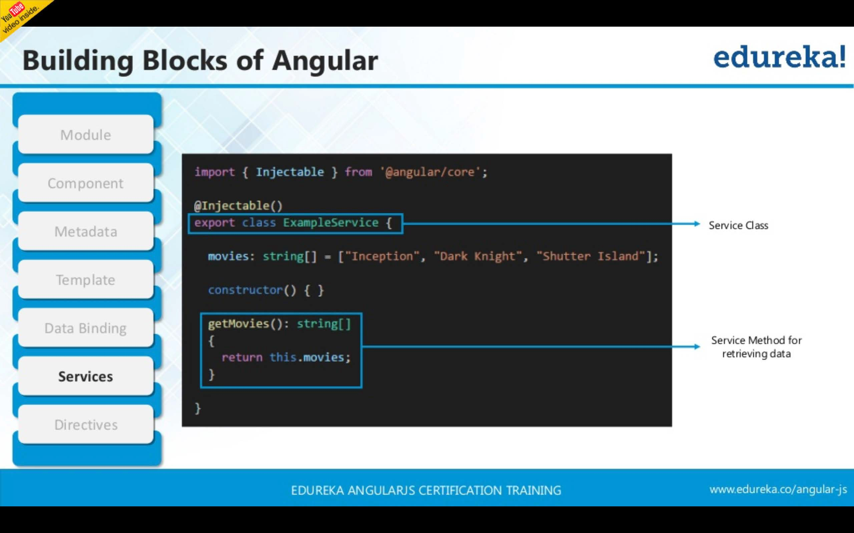

Slide 33
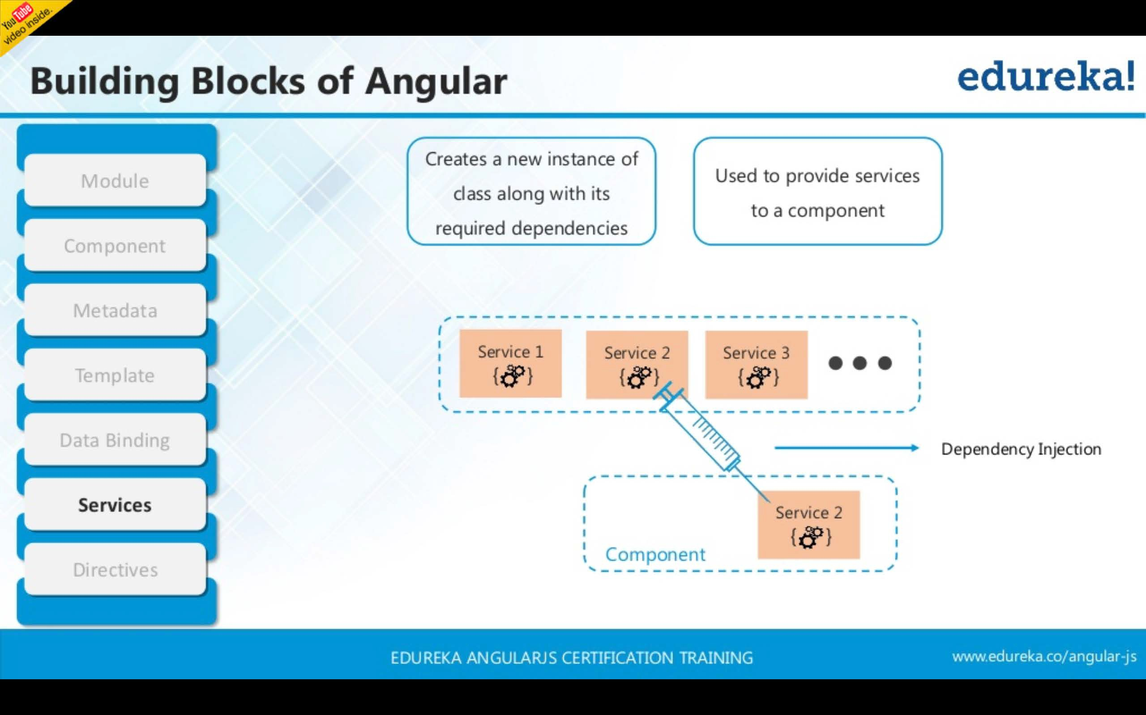

Slide 34
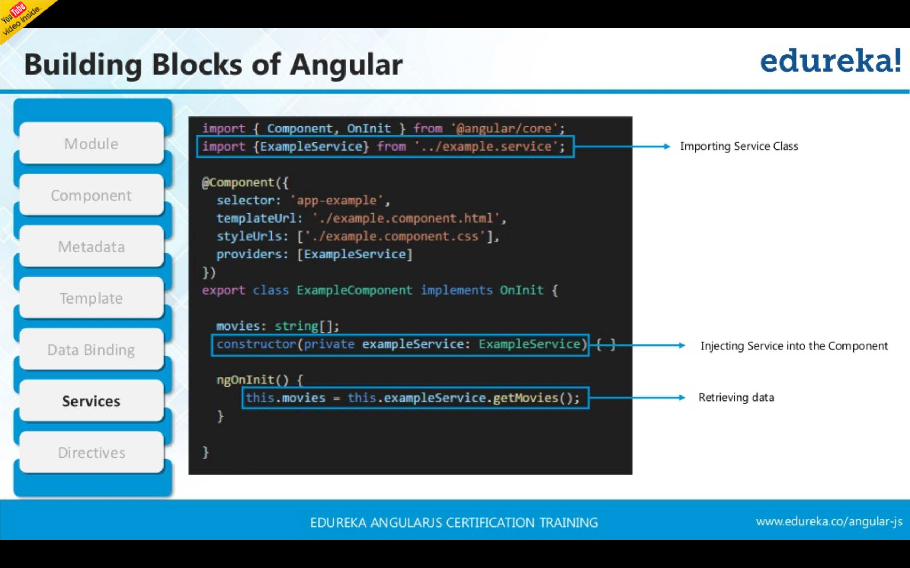

Slide 35
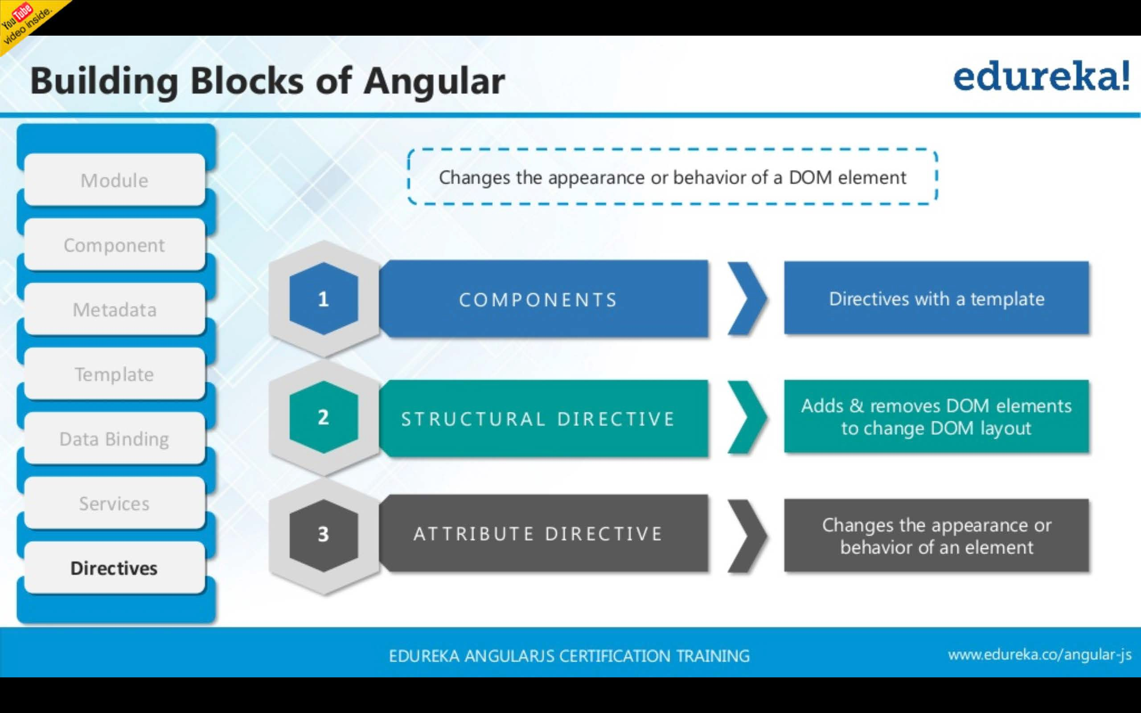

Slide 36
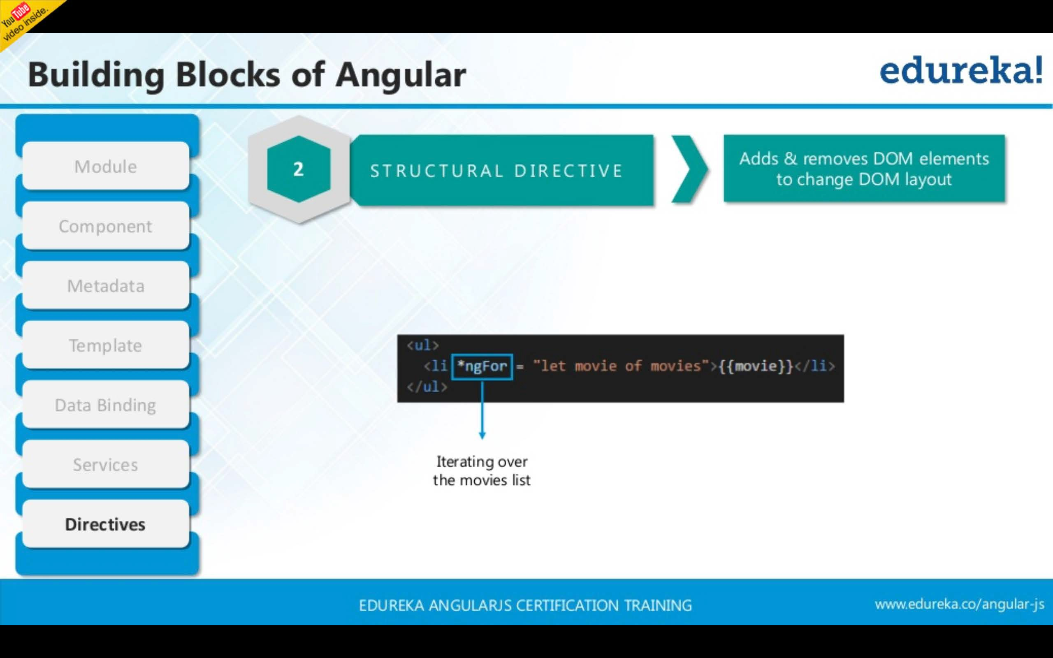

Slide 37
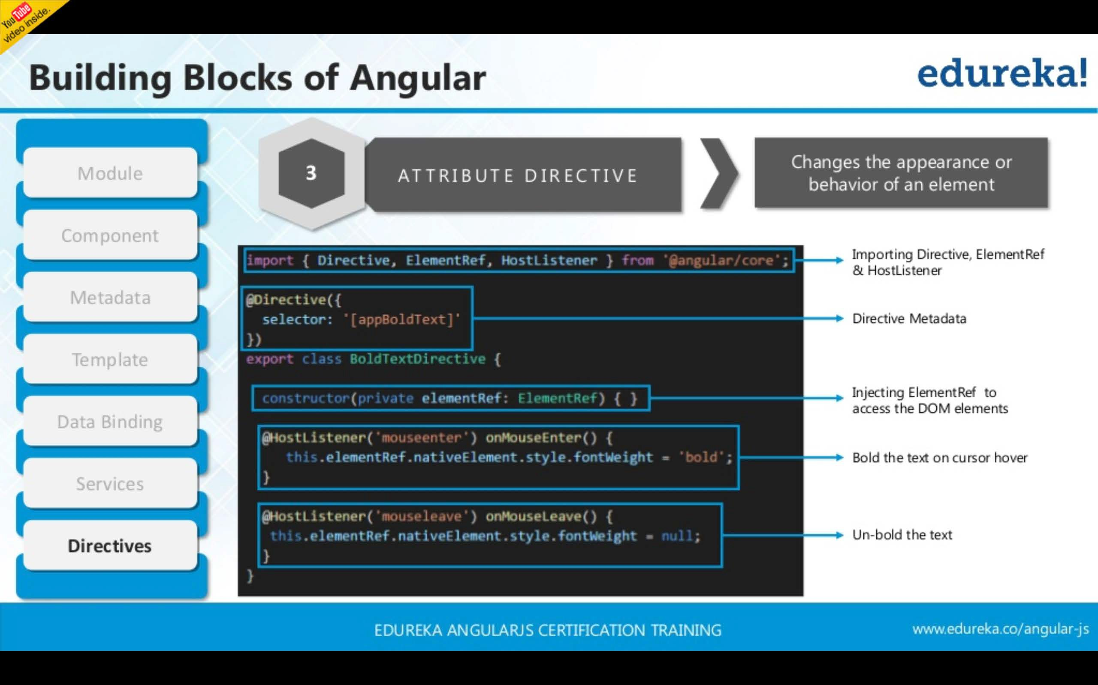

Slide 38


Slide 39
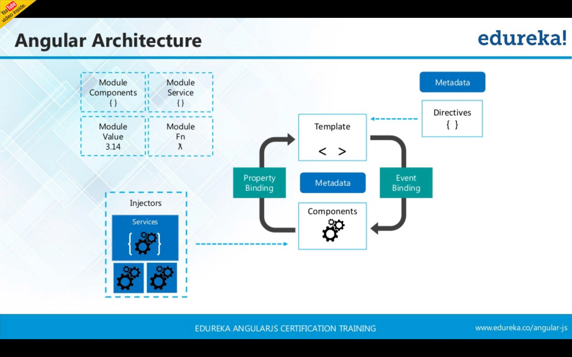

Slide 40
References
Edureka! Angular Tutorial
https://www.slideshare.net/EdurekaIN/angular-4-tutorial-whats-new-in-angular-4-angular-training-edureka
Tutorial: Tour of Heroes
https://angular.io/tutorial
An Overview of Angular 4
https://www.slideshare.net/Cynoteck/an-overview-of-angular-4
Lecture Notes (Angular)
http://oak.cs.ucla.edu/classes/cs144/notes/pdf/angular.pdf

